Slide 1
Silicone Molding and Resin Casting Small Parts
Kate Szkotnicki
Kansasfest 2016

Slide 2
Agenda
Silicone Mold Making Materials
Silicone Mold Making Demo
Resin Casting Materials Needed
“Casting” Demo
Q/A

Slide 3
Mold Making: Materials

Slide 4
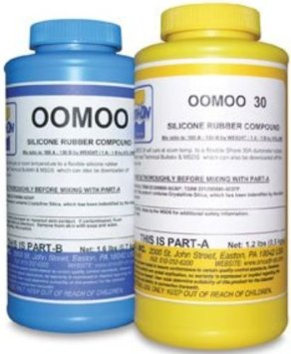
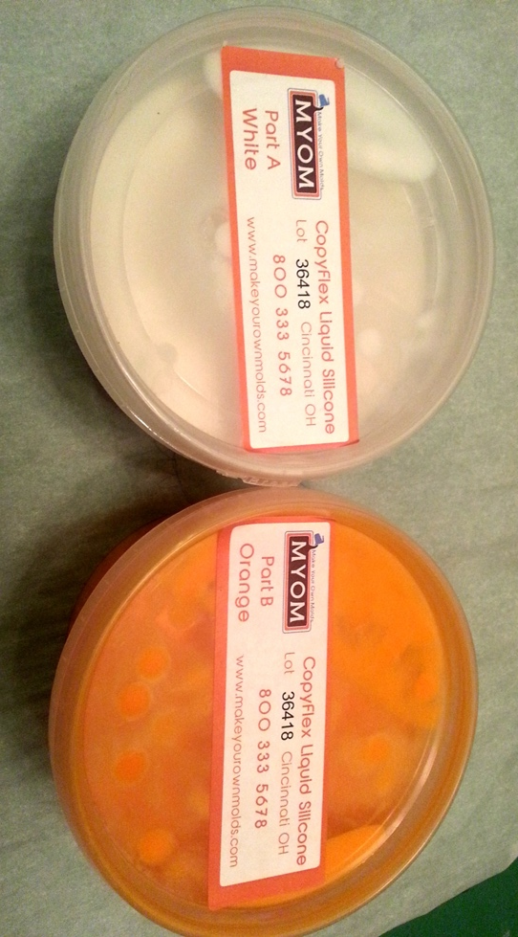
A/B Silicone
Different makes
Some are food-safe
Some are 1:1, some are other ratios
All require CAREFUL MEASURING AND MIXING
“Pot Time” – how long you have to work

Slide 5
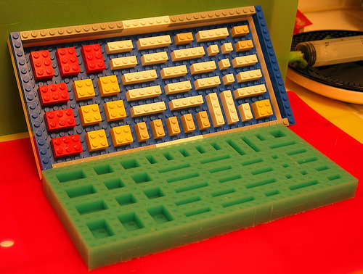
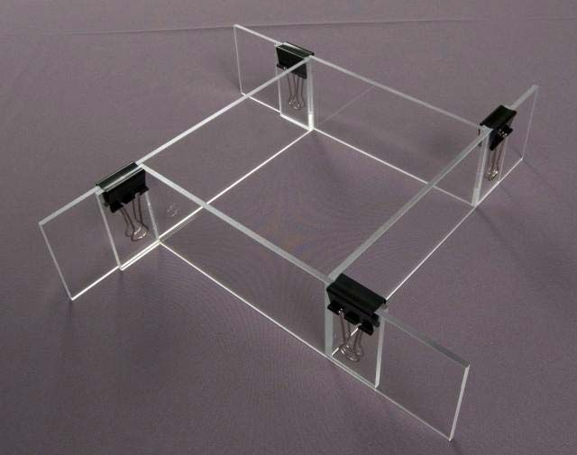
Mold Box
Should be ½” around all sides of your part/parts
Needs to contain a liquid
Several options
  Legos/Clay
  Plexiglass and Hot Glue
  Styrofoam

Slide 6
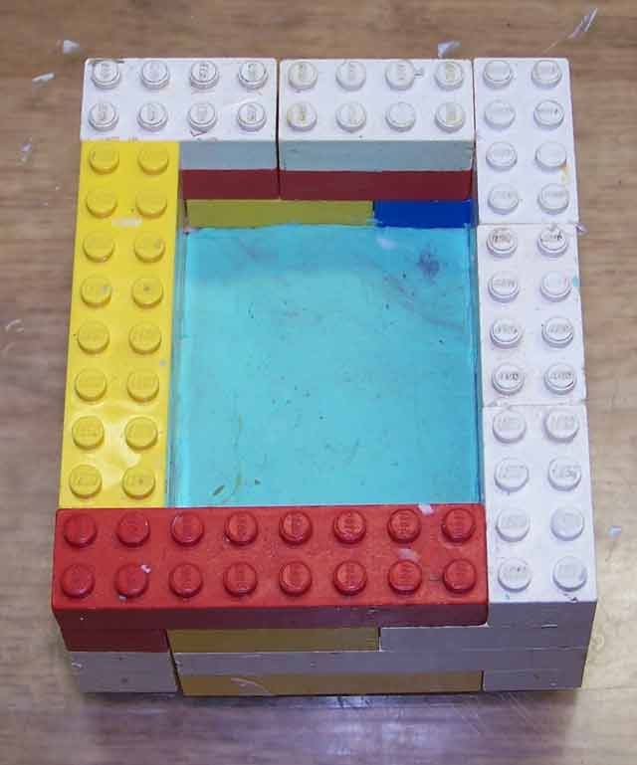
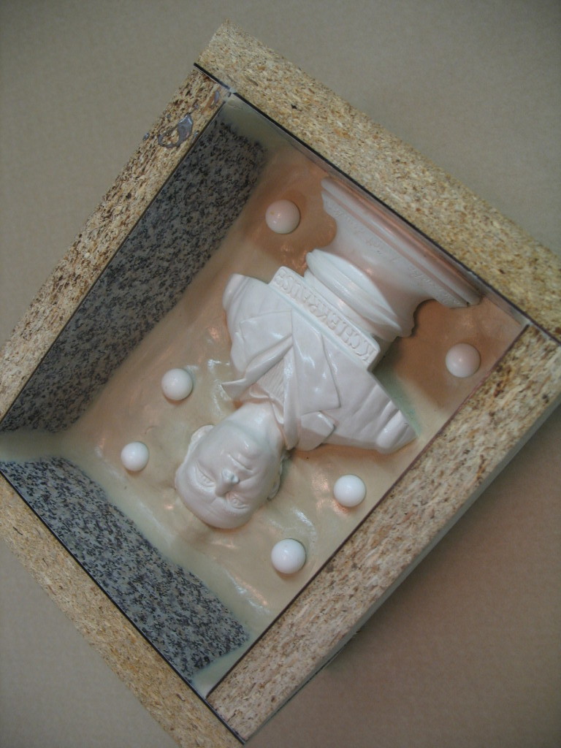
Clay
Optional for 1-part molds
  Sealer
Required for 2-part molds
  Make half a mold at a time
Needs to be inert
  Sulfur Free

Slide 7
Other Supplies
Disposable Supplies
  Mixing container(s)
  Paint stir sticks
Reusable Supplies
  Mold Key Makers (acorn nuts, marbles)
  Release Agent
  Digital Scale

Slide 8
Mold Making Demo (1-piece)
Build Box
Attach part to box securely
Seal box if needed
Measure A and B (equal amounts in this case)
Mix once
Pour into second container, mix again
Slowly and carefully pour mold
Let cure

Slide 9
Resin Casting: Material

Slide 10
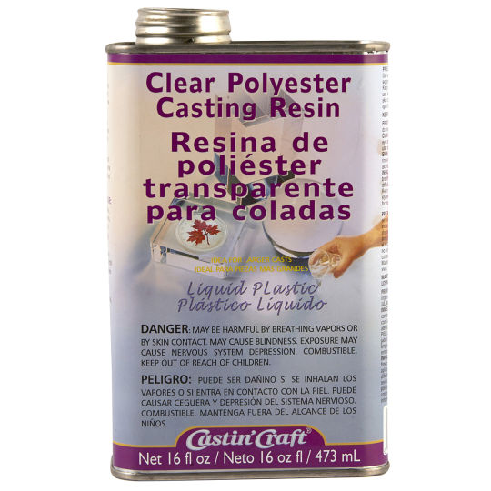
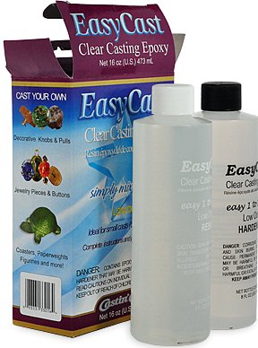
Resin
Comes in 2 parts
  Resin
  Catalyst
  Some are 1:1, others use higher ratios
Different Chemical Formulae
  Polyester
  Polyurethane
  Epoxy

Slide 11
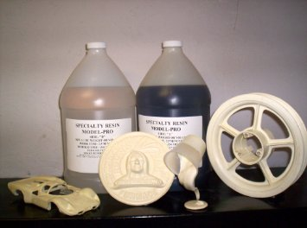
Resin Continued
Many different brands
  Craft Grade (Castn’Craft)
  Model Making
  Prototyping
  Fiberglassing
Read Information
Try it first!

Slide 12
Other Materials
Heat-Safe Disposable Container
  Aluminum Cans
  NO WAX
Disposable mixing sticks
Mold Release
Rubber Bands

Slide 13
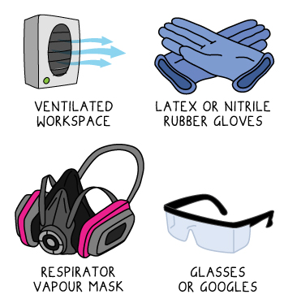
Safe Casting
Safety Gear
  Eye Protection
  Respirator/mask
  Disposable gloves
Work outside or in a well-ventilated area
Some are more dangerous than others

Slide 14
Resin Casting Steps
Work in a well-ventilated area with safety gear
Clean and dress molds (mold release)
  Put 2-part molds together with bands/tape
Mix resin according to directions
  Sometimes you need more catalyst
  May not get it on the first try!
Pour slowly
Allow to cure

Slide 15
Special Resin Considerations
Pressure Casting
  Allowing the piece to cure in a pressure vessel
  Avoids surface air bubbles
  Needs special equipment (pressure pot, compressor)
Parts don’t come out ready
  May probably need sanding/polishing
  Wet or dry sand
  Polyester will be tacky on the exposed parts

Slide 16
“Resin” Casting Demo
Not really
Jello Gummy Candy ☺
Same technique, safer material for demo

Slide 17
Questions/Answers?

