Slide 1
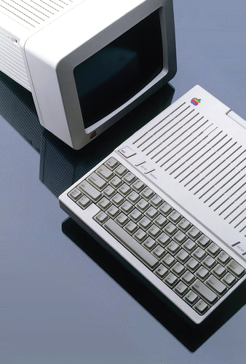
Apple //c
An Apple adventure
Notes:
Thank you to Chris Torrance and Kansas Fest
Lot’s of adventures at Apple > some with products, some with colleagues, some with Steve…

Slide 2
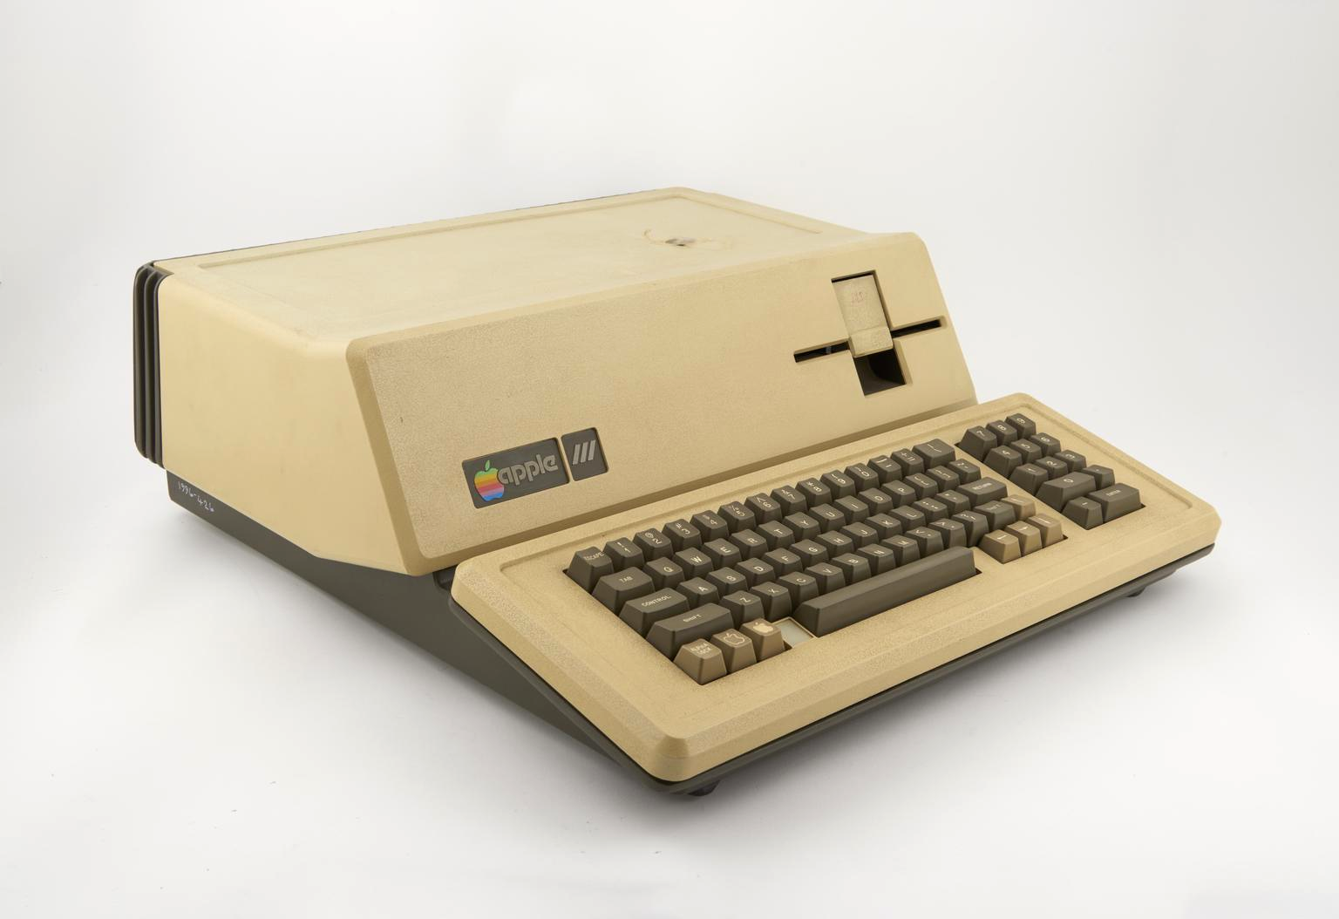
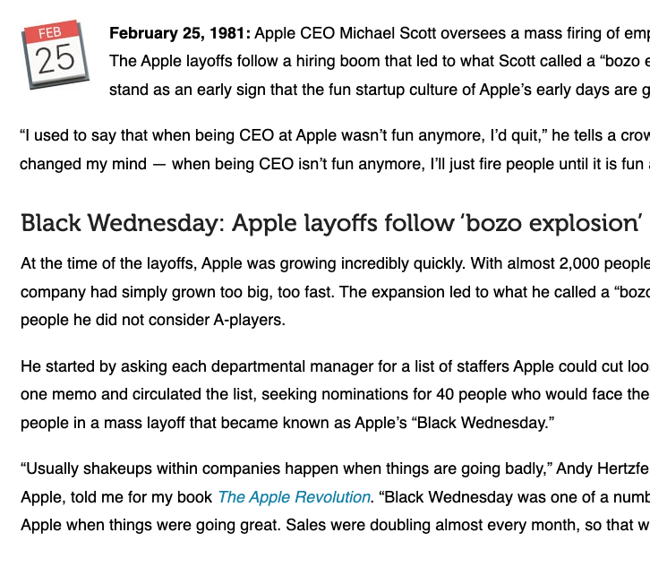
Notes:
I joined an during an Apple /// hangover
Apple’s first layoff - Black Wednesday > dozens of phone calls
> Don’t need to call any more

Slide 3
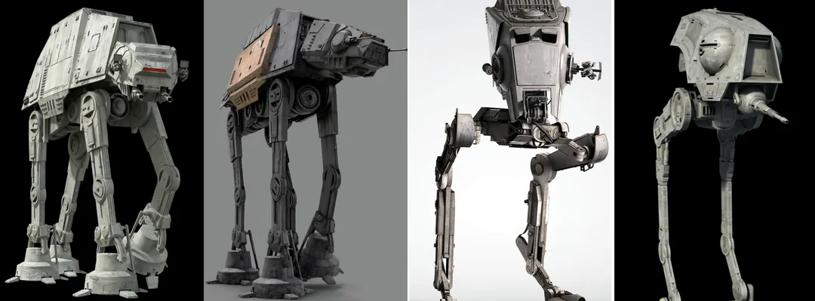
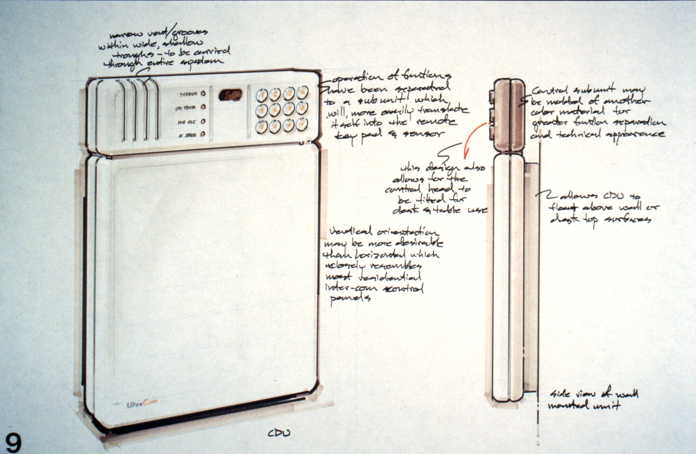
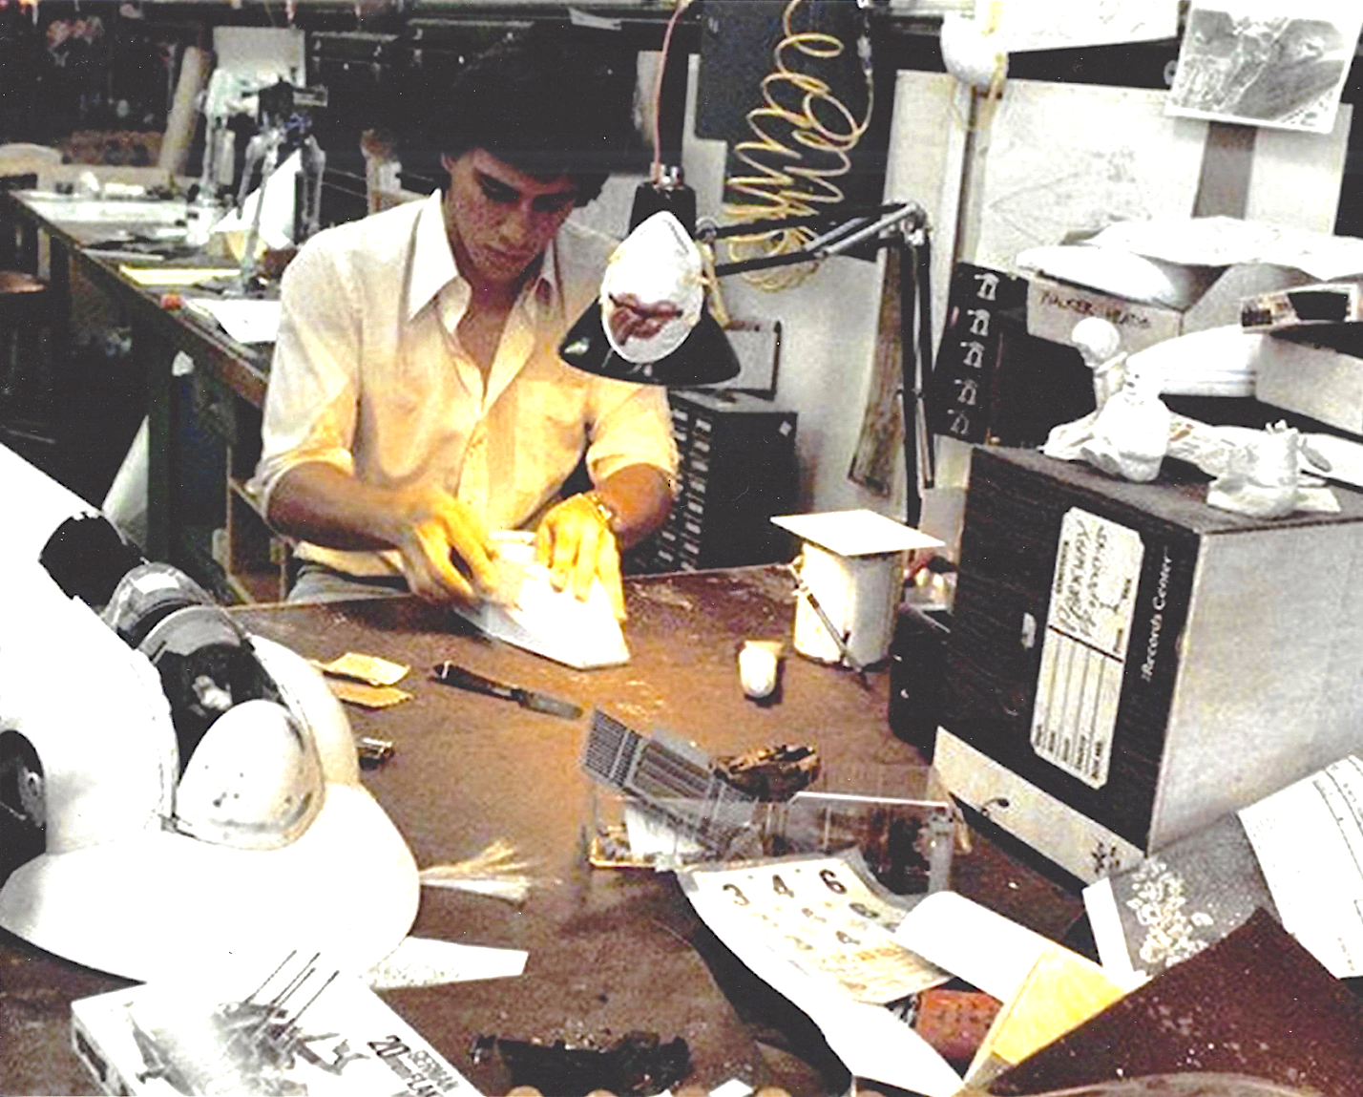
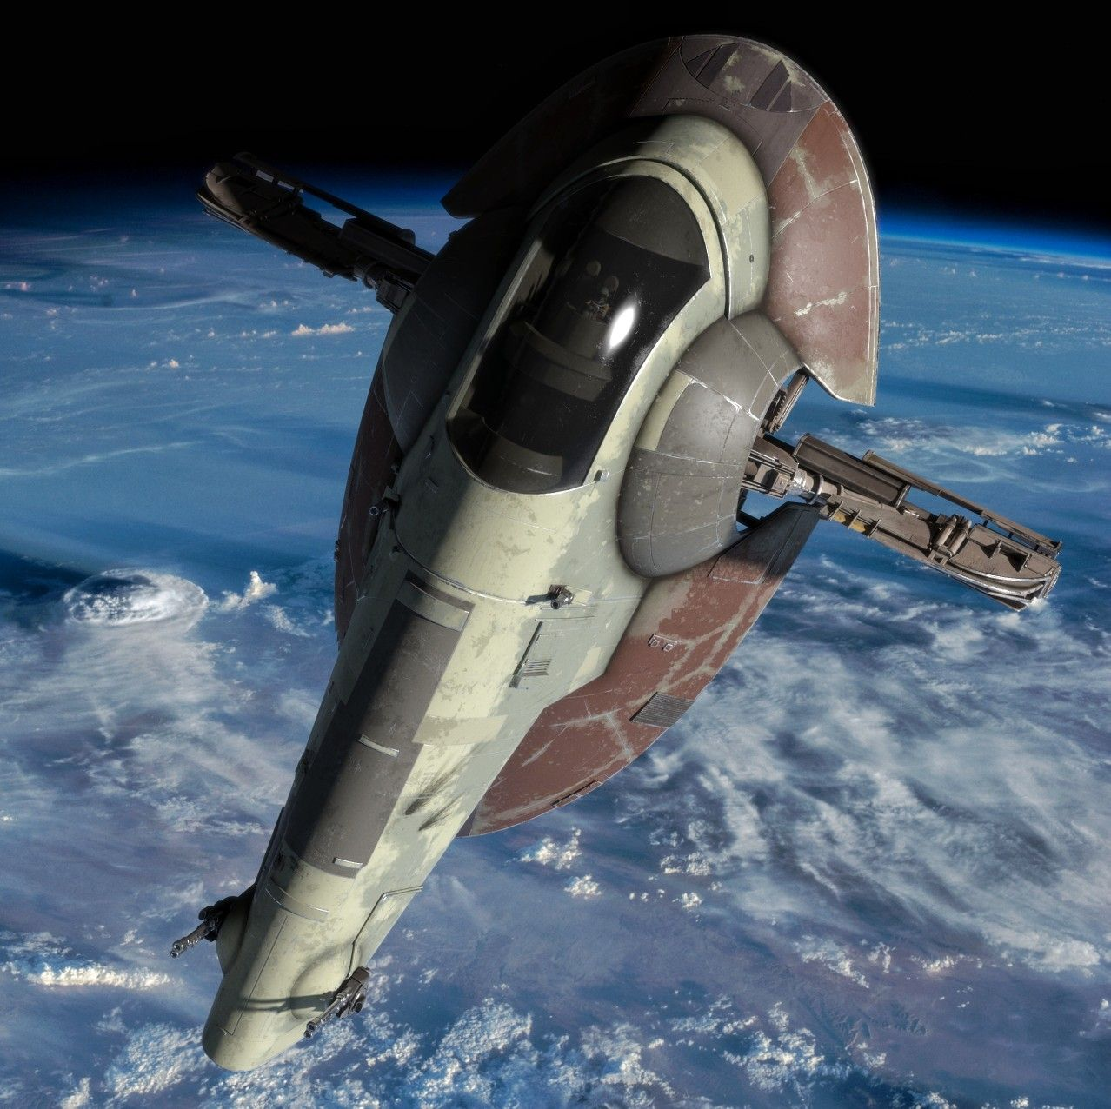
Notes:
Apple staffing - not scientific

Slide 4
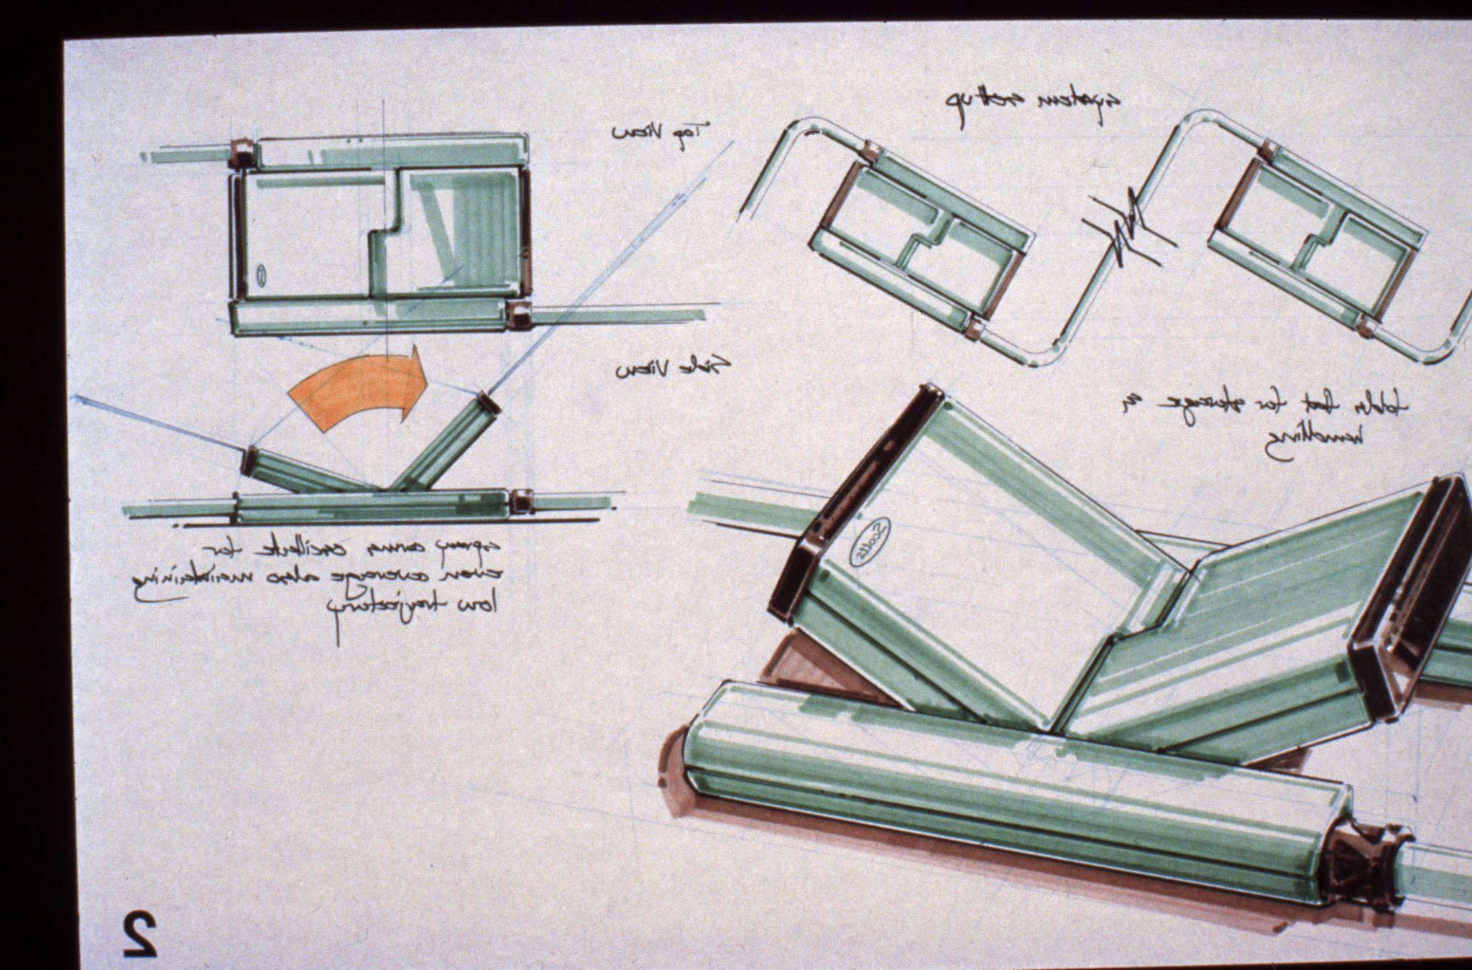
Notes:
Before I joined Apple

Slide 5
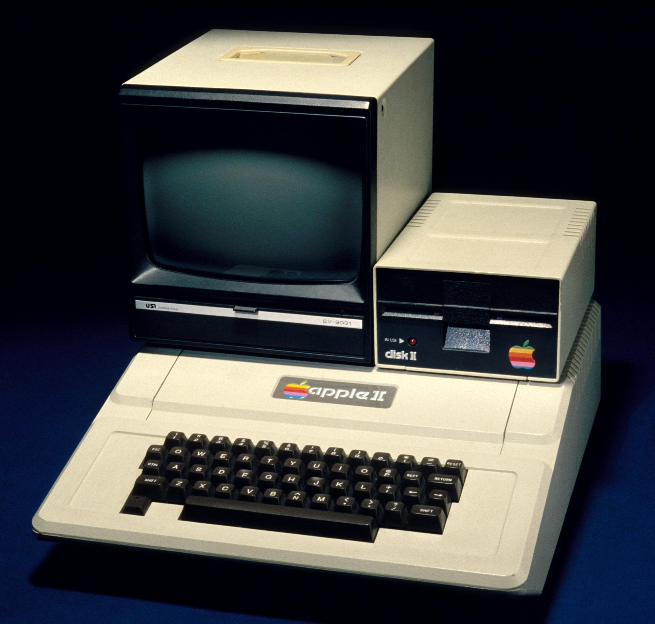
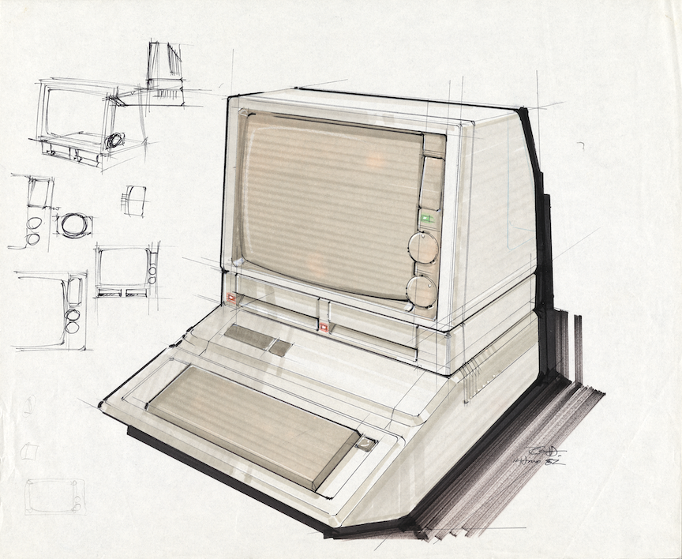
Notes:
Apple II > 6.14.82 - Apple IIe

Slide 6
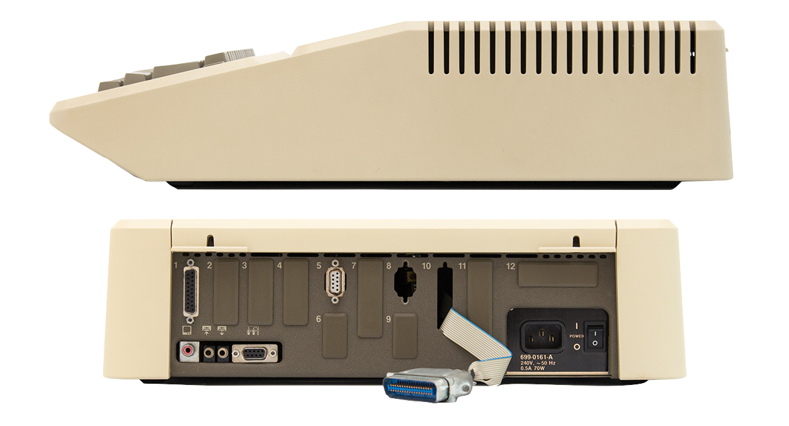
Notes:
6.14.82 - Apple IIe
Lot’s of chamfers and HP colors

Slide 7
Notes:
Apple II Modem - 3.30.82
Into the deep end

Slide 8
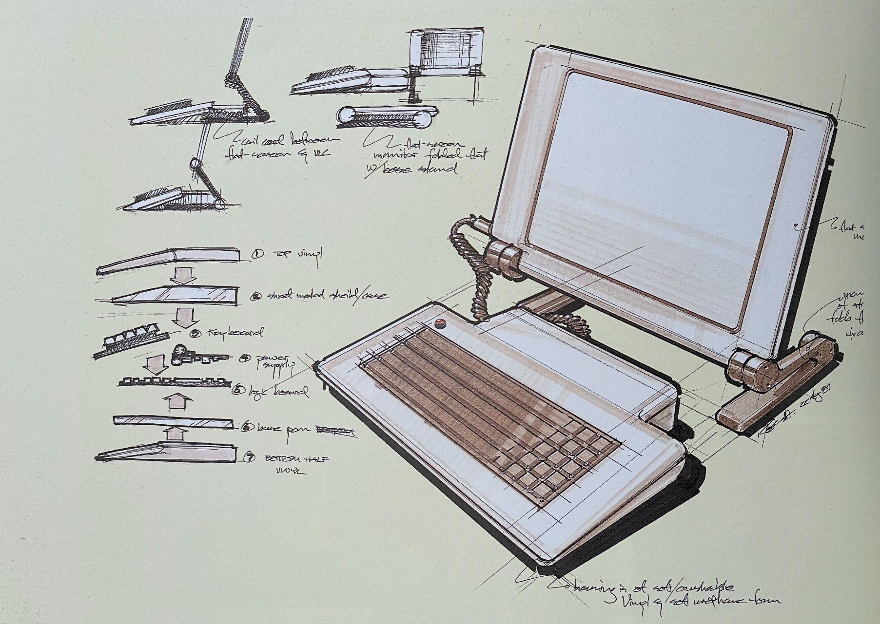
Notes:
Swimming but to where?

Slide 9
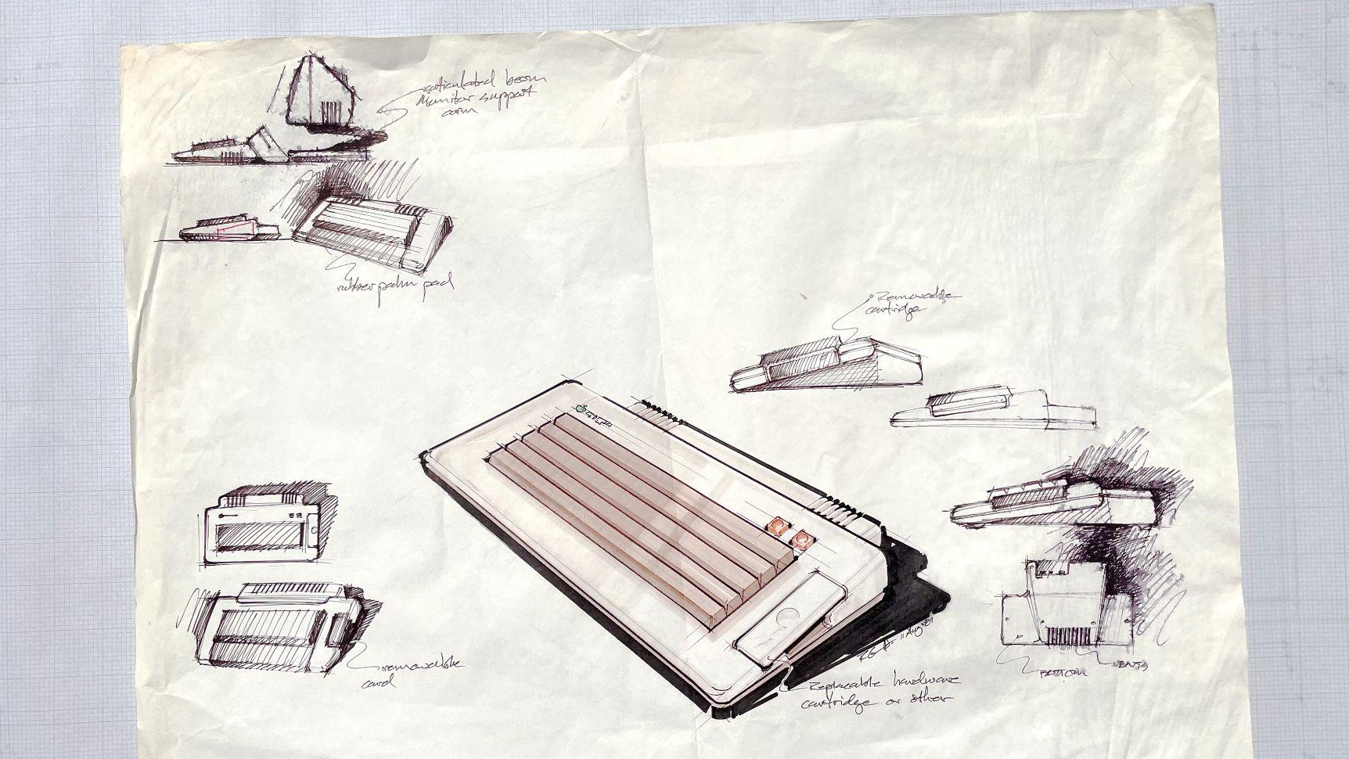
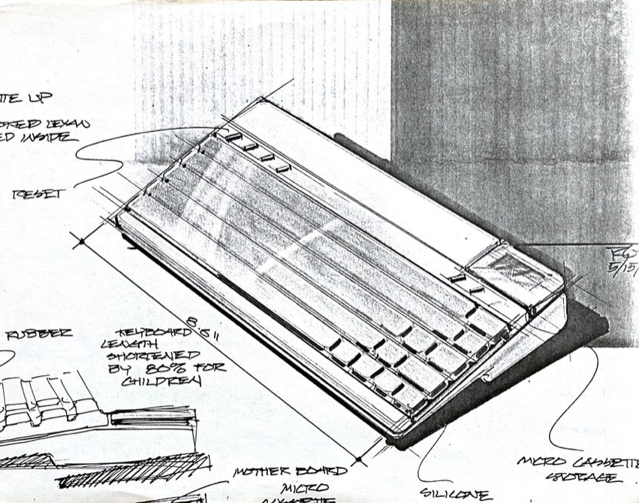
Notes:
11.8.81 Exploring what could be done, and how to gets Steve’s interest

Slide 10
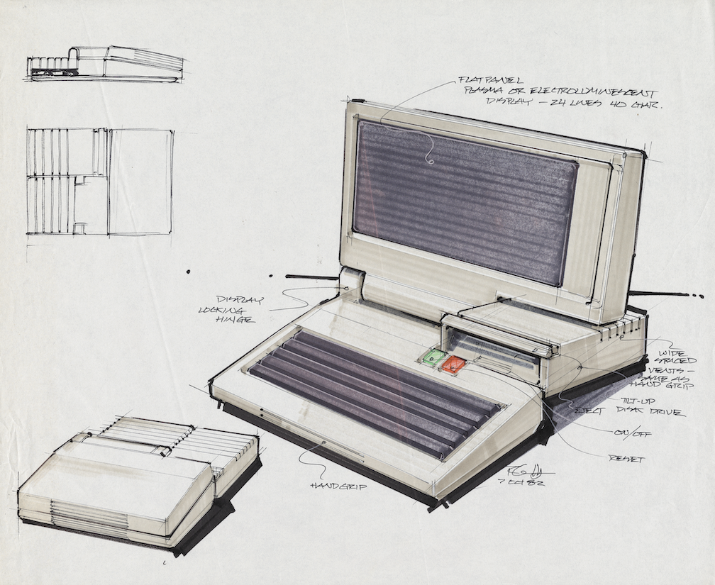
Notes:
A Portable Apple II?

Slide 11
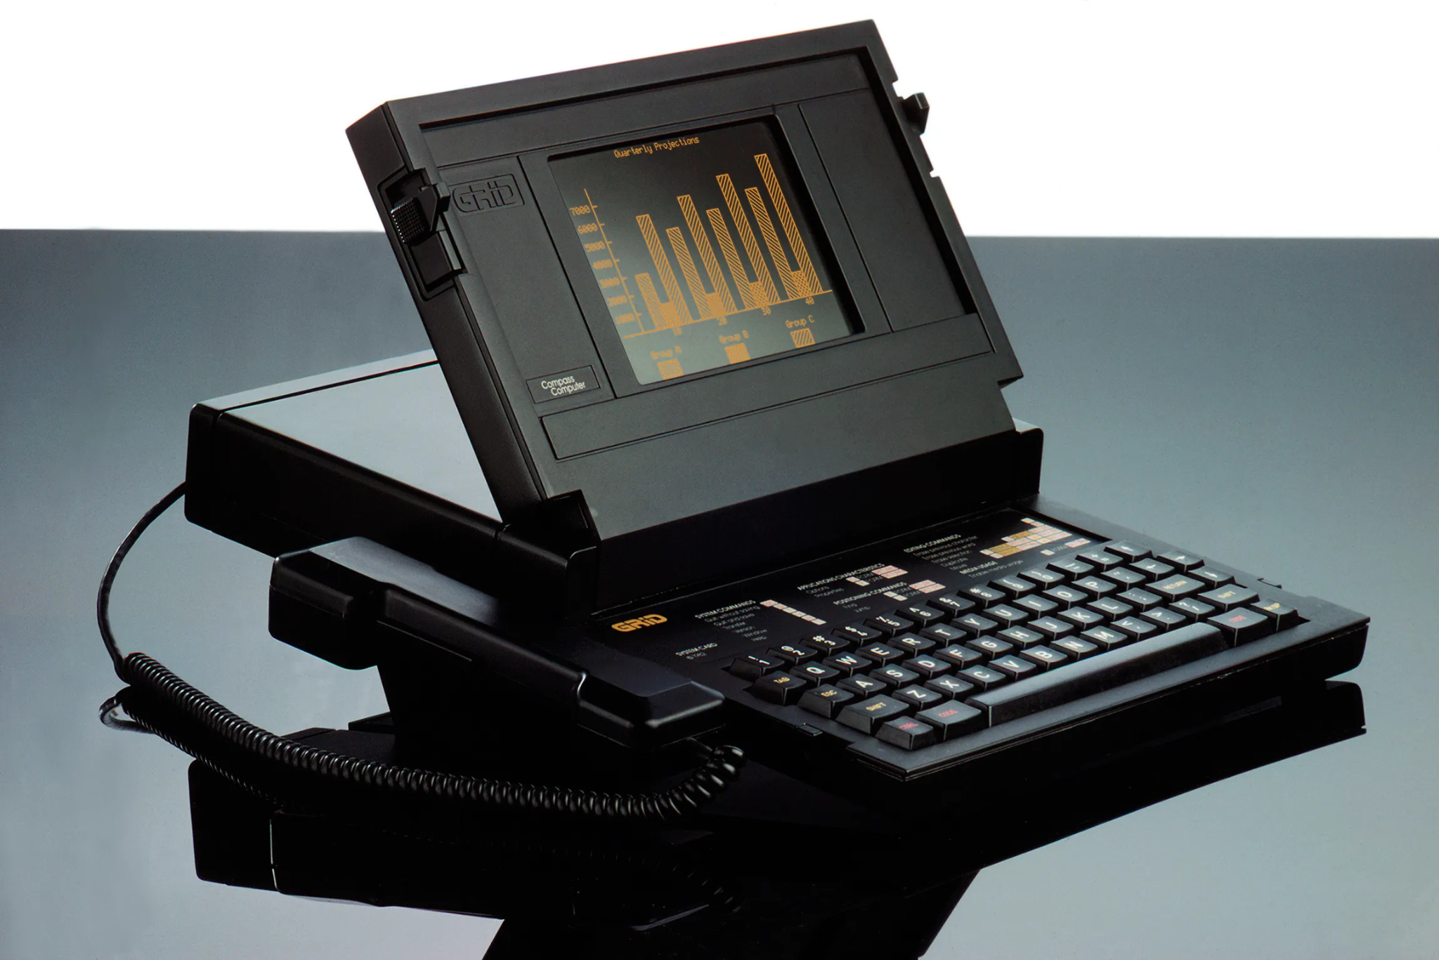
Notes:
Grid computer - Wow!

Slide 12
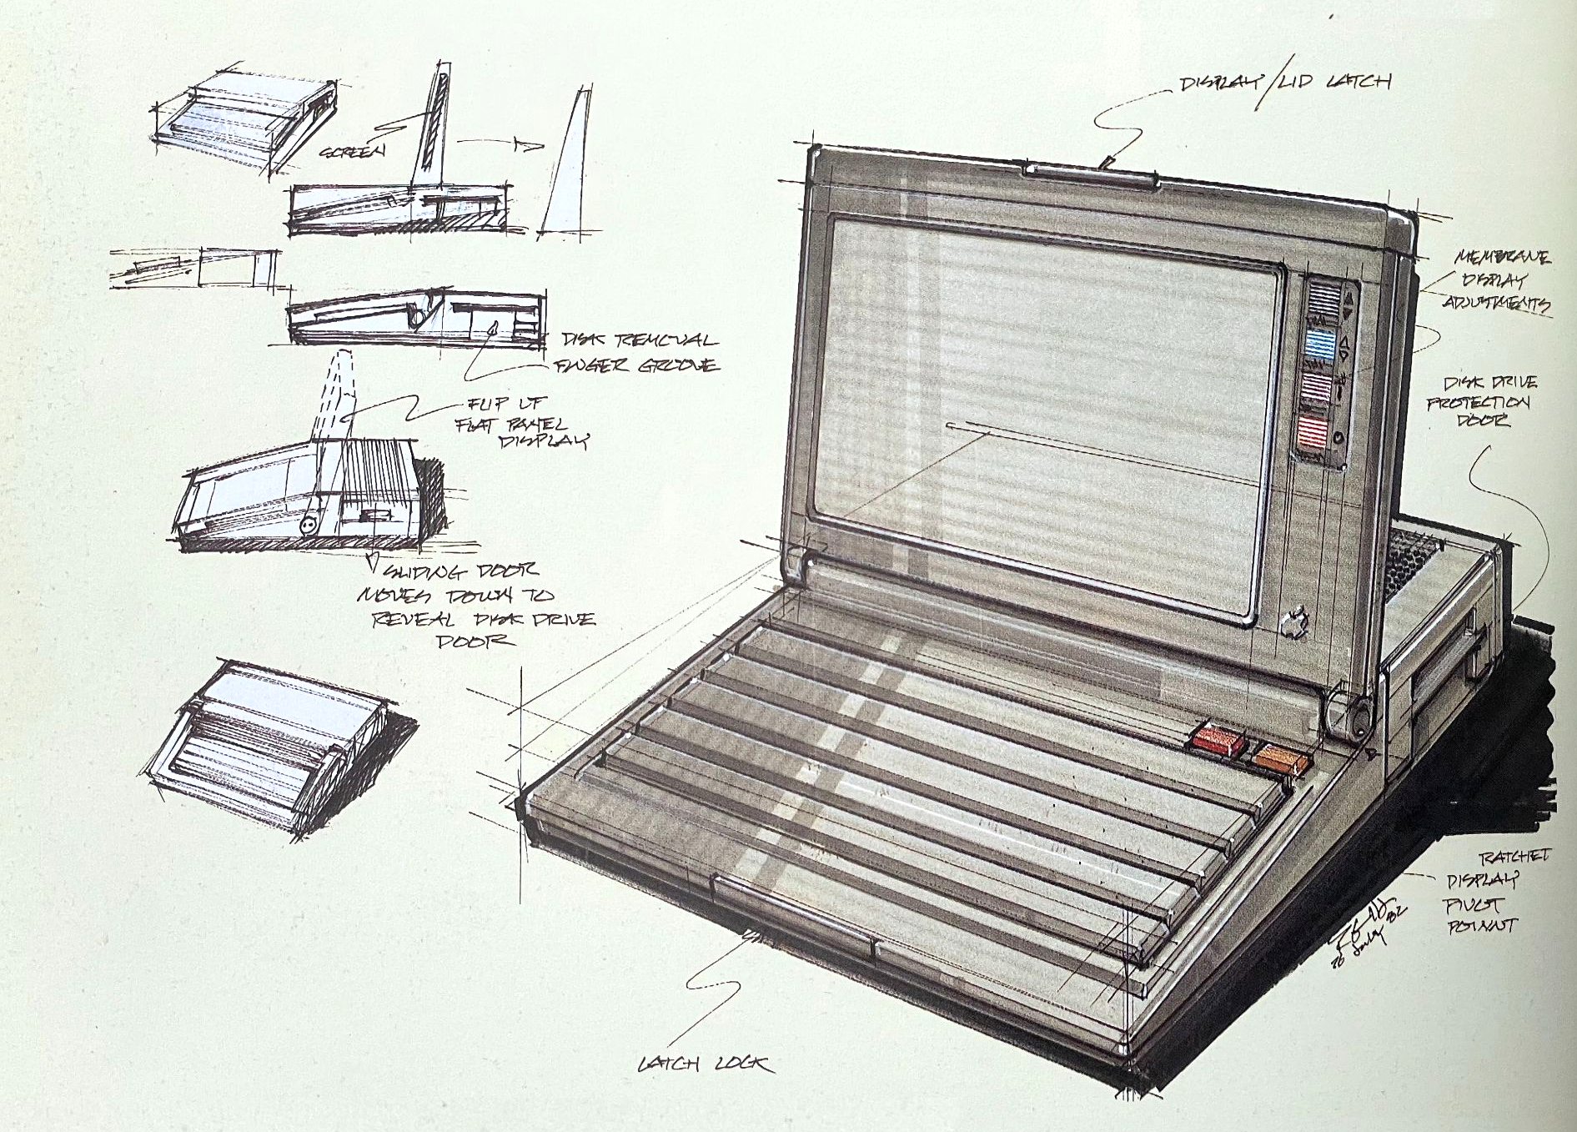
Notes:
A serious Apple IIx?

Slide 13
Notes:
Apple II next __?__ > Moby, Teri, Phillie, ELF
Price point too high vs. Mac > Needed lower cost Apple II

Slide 14
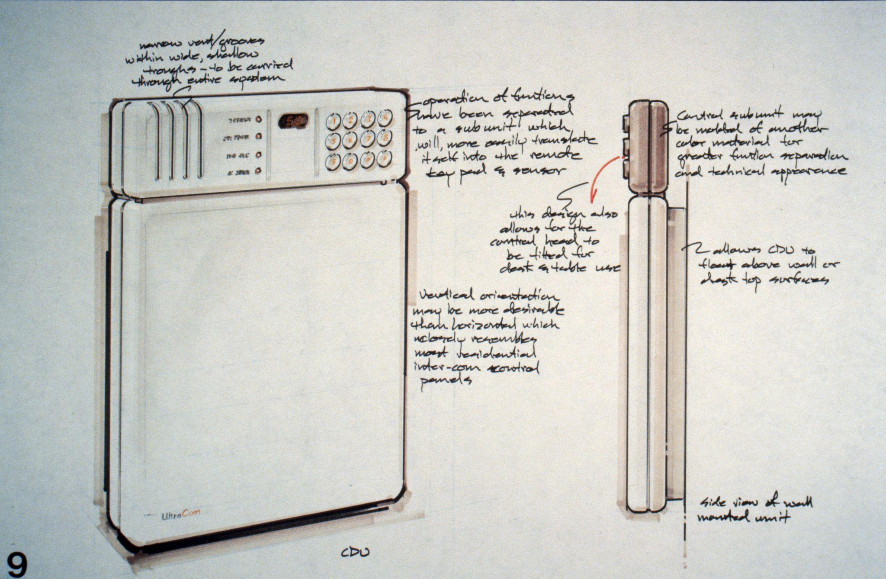
Notes:
Fresh thinking, —But not lead by the youngest designer

Slide 15
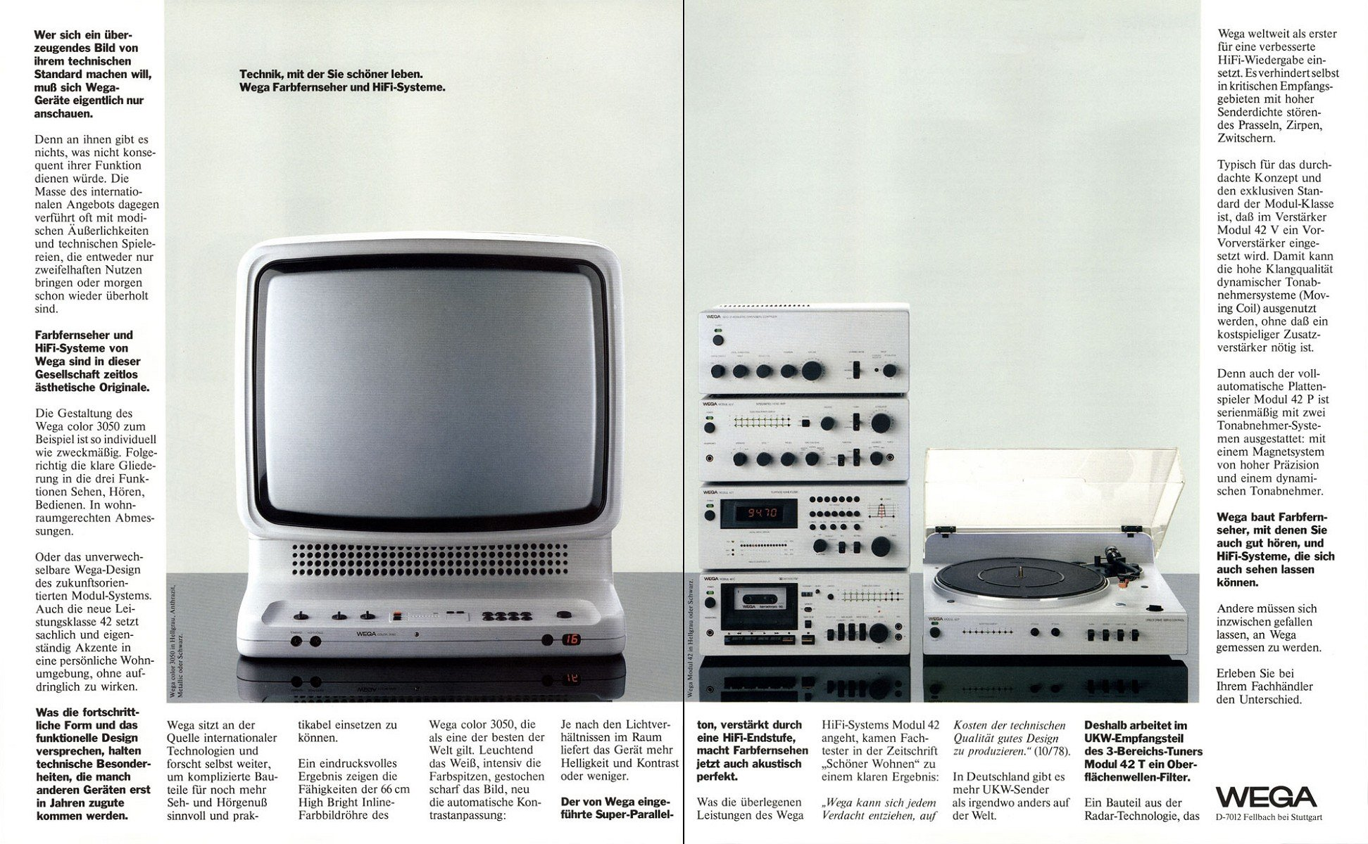
Notes:
Enter Hartmut Esslinger

Slide 16
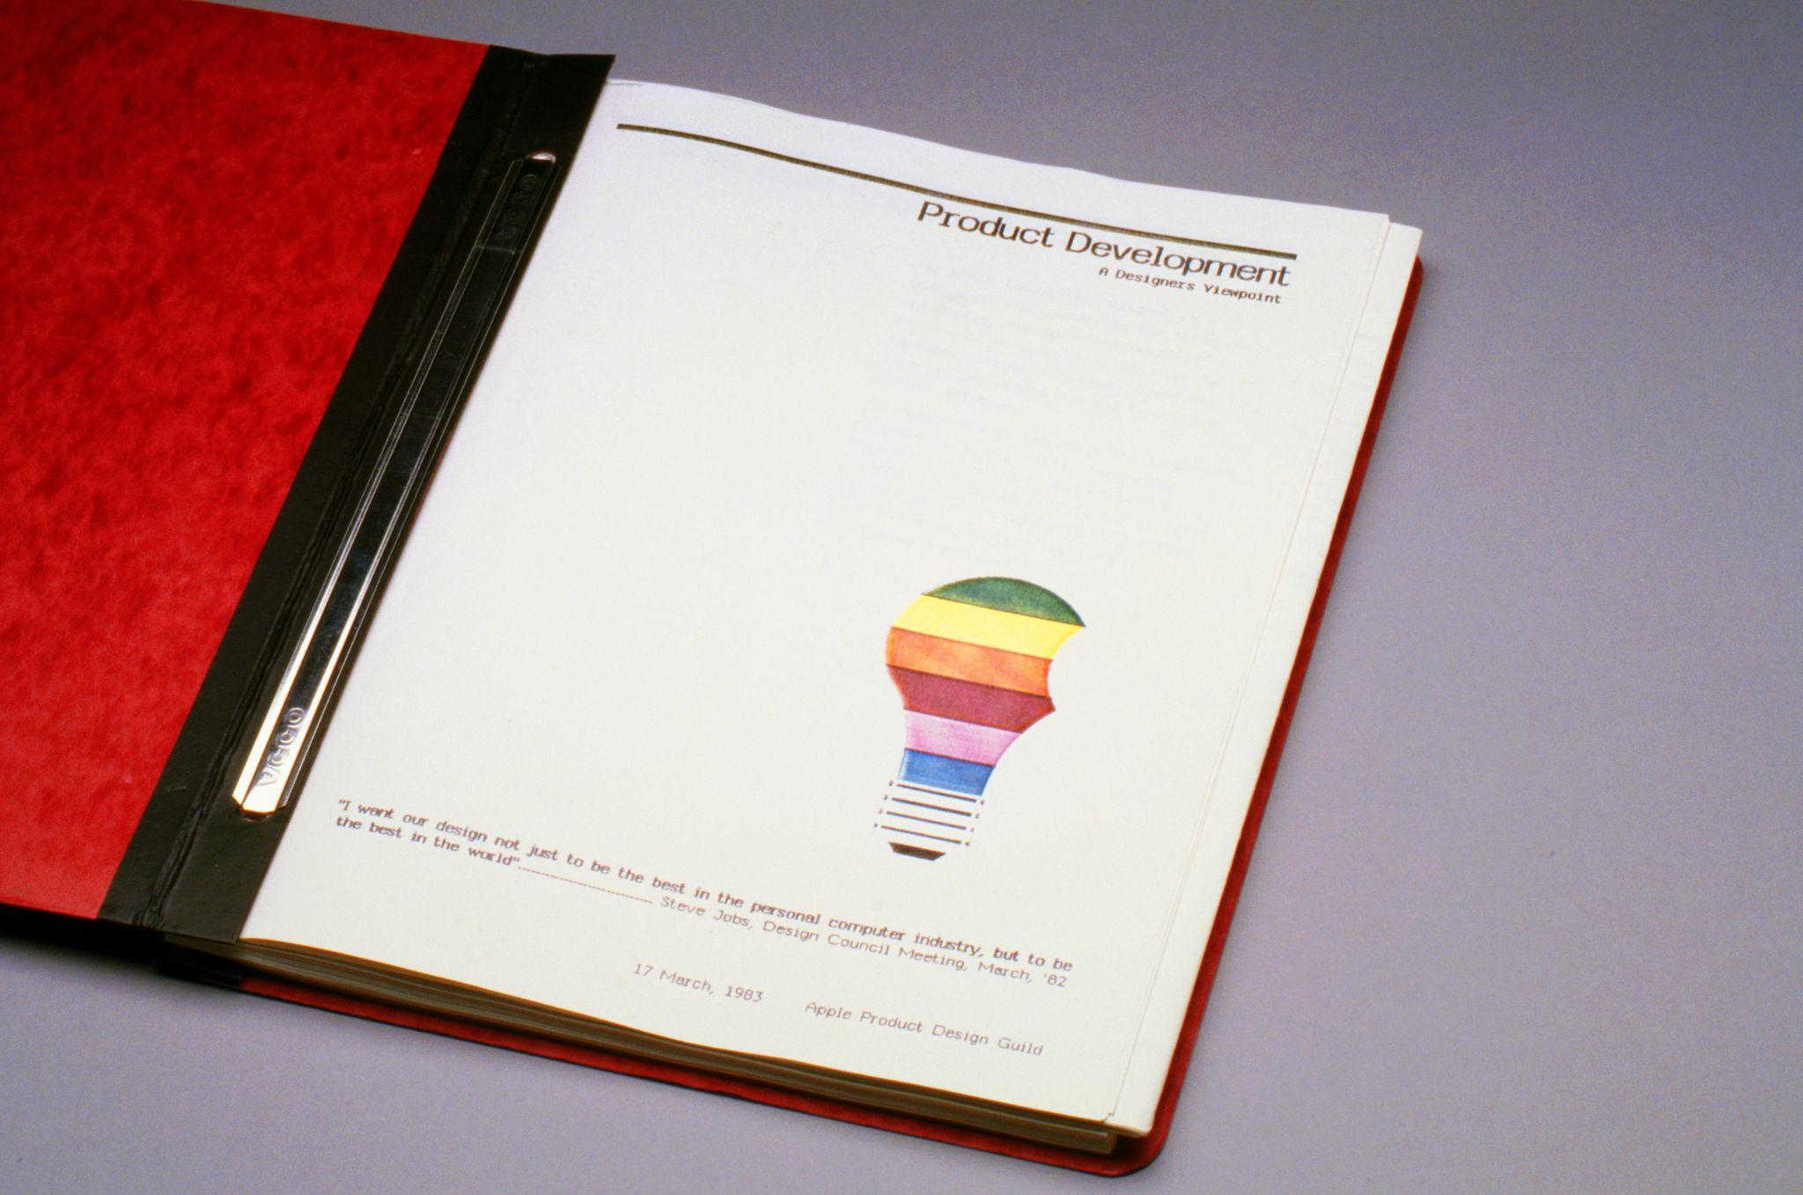
Notes:
Snow White Project - Jerry Manock

Slide 17
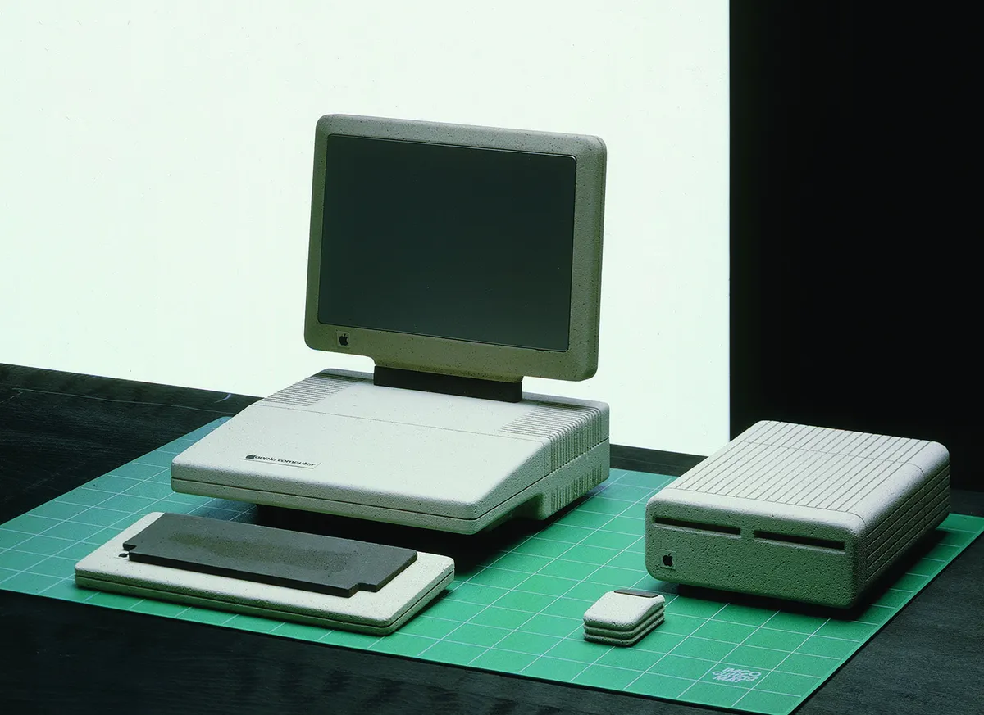
Notes:
Snow White Project

Slide 18
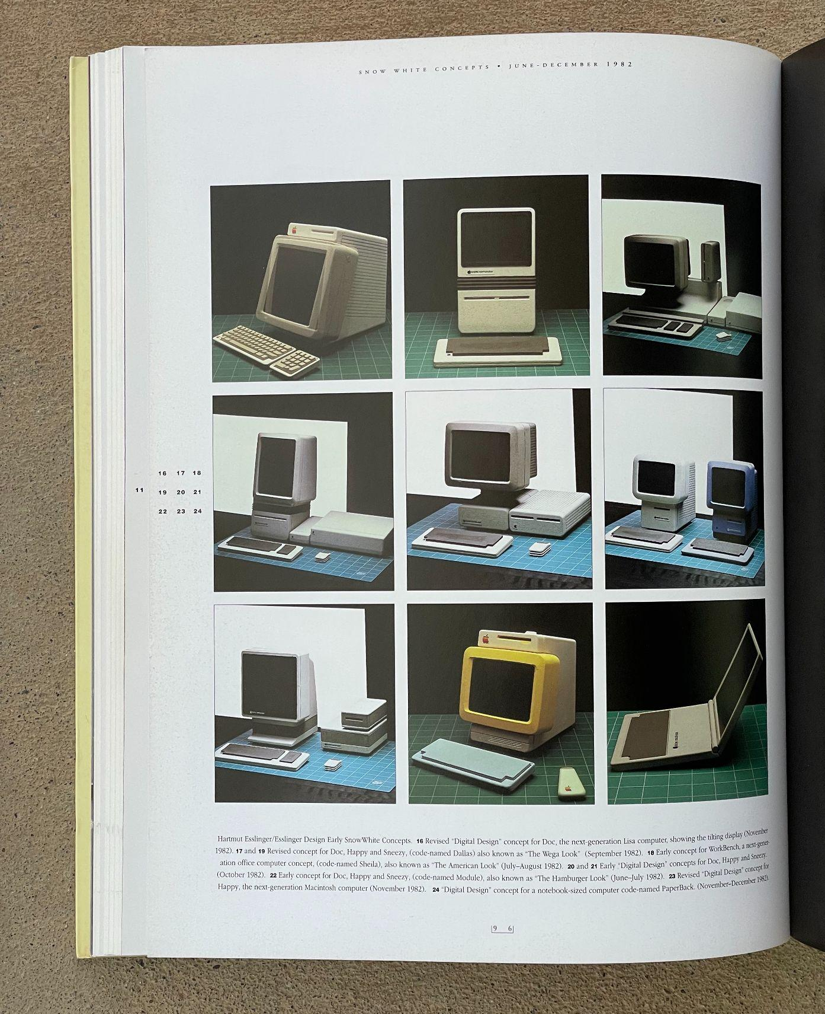
Notes:
Frog wars

Slide 19
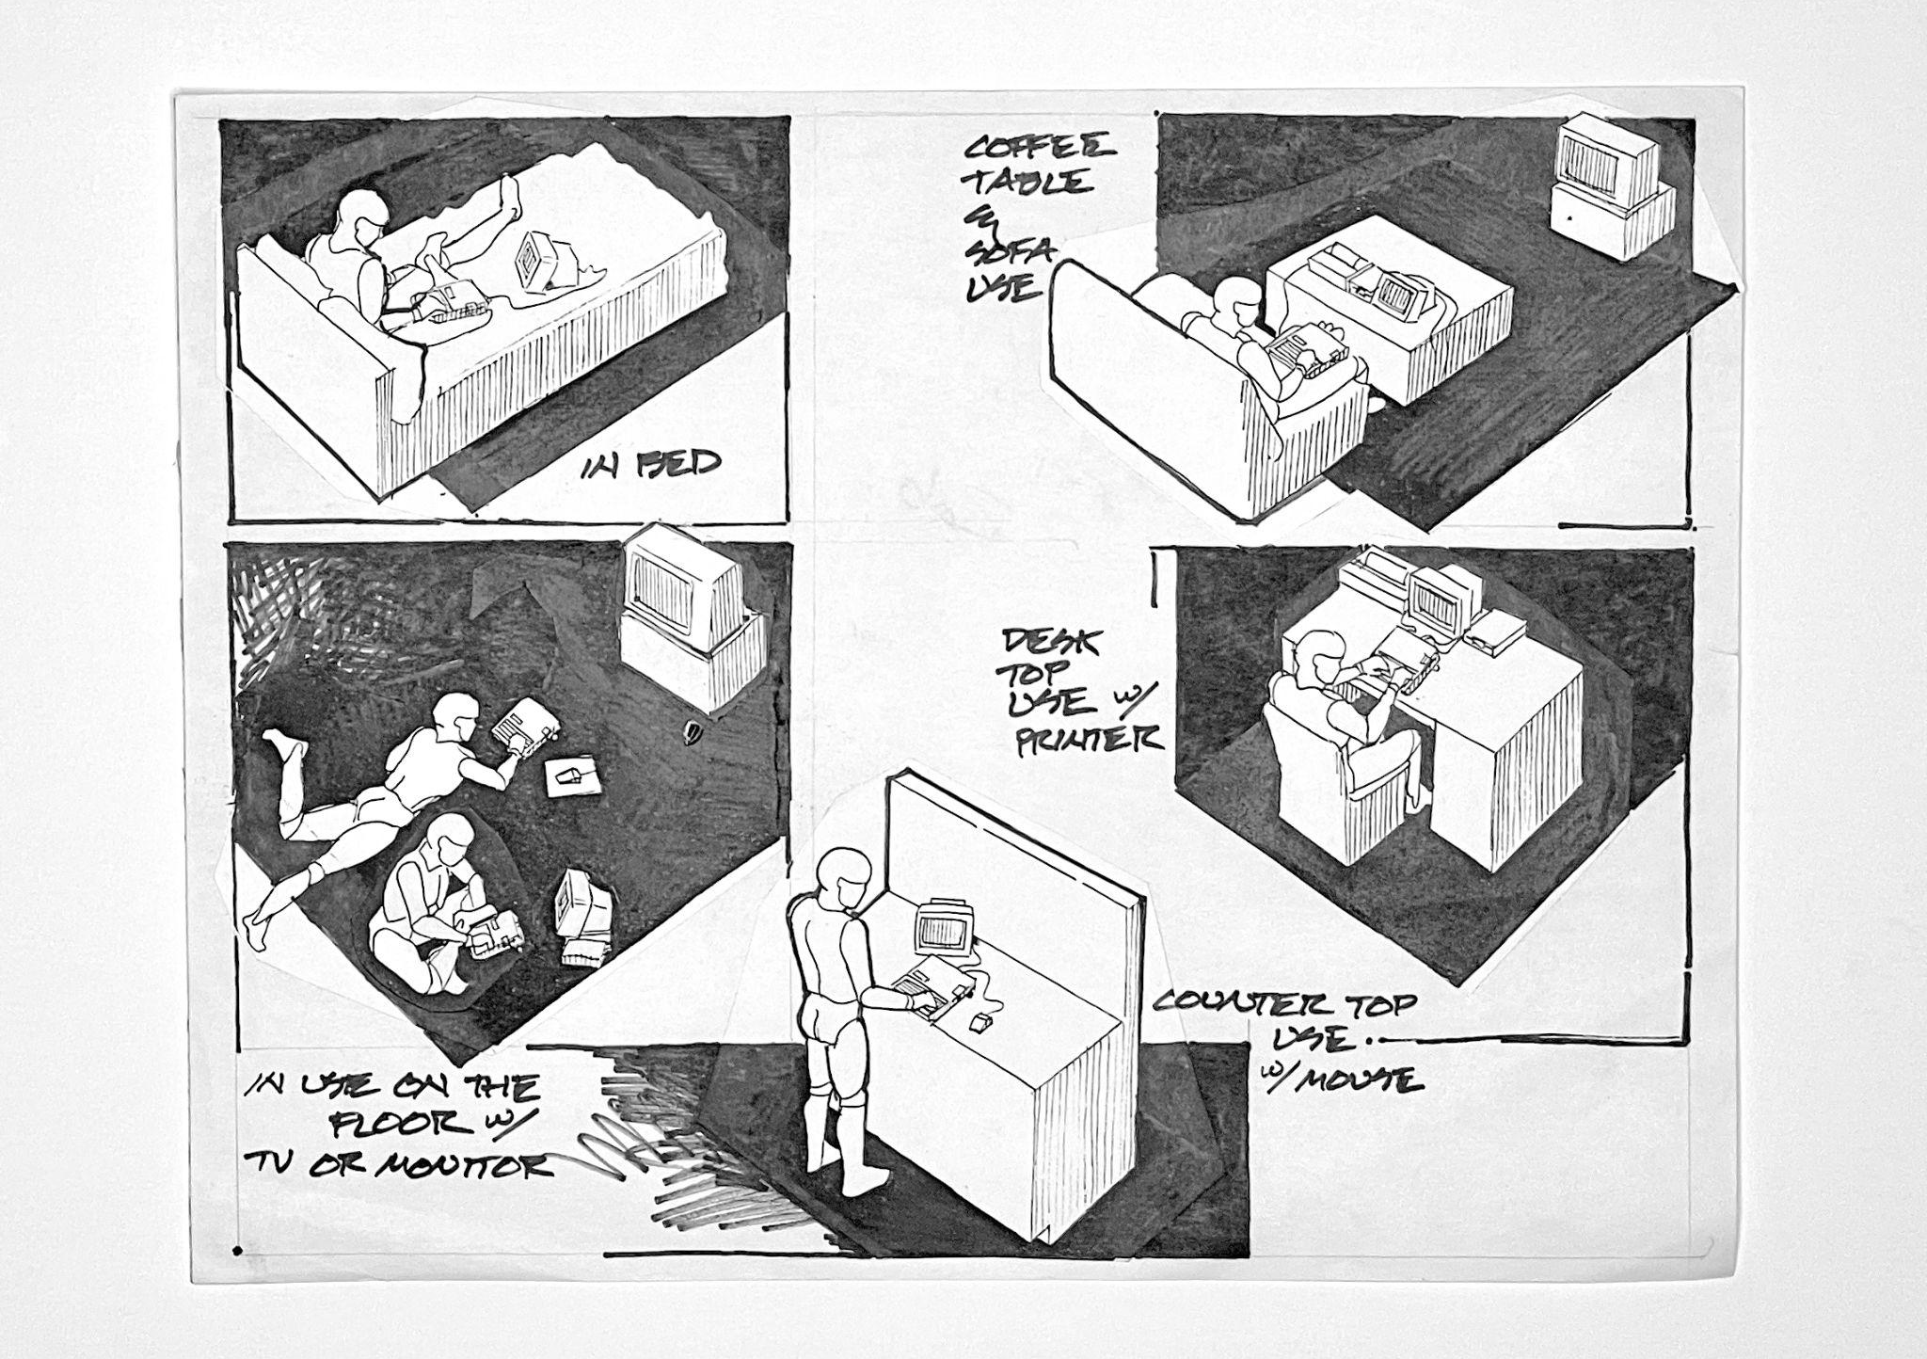
Notes:
Compact vs. Cuddly

Slide 20
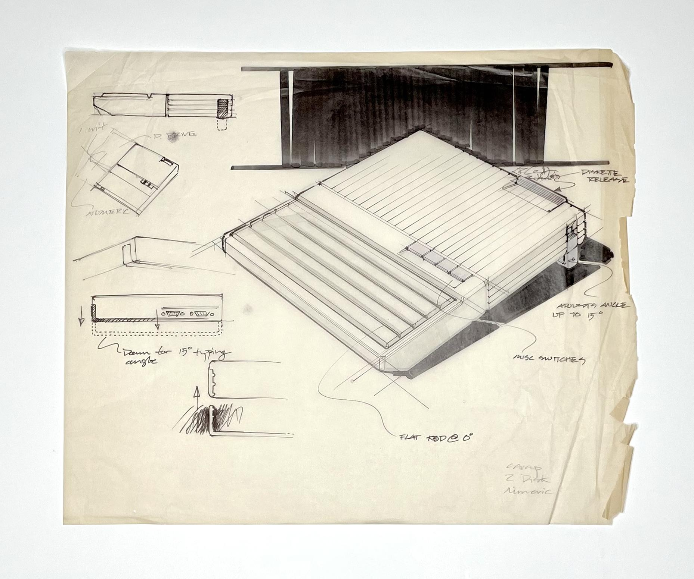
Notes:
What is this piece of…

Slide 21
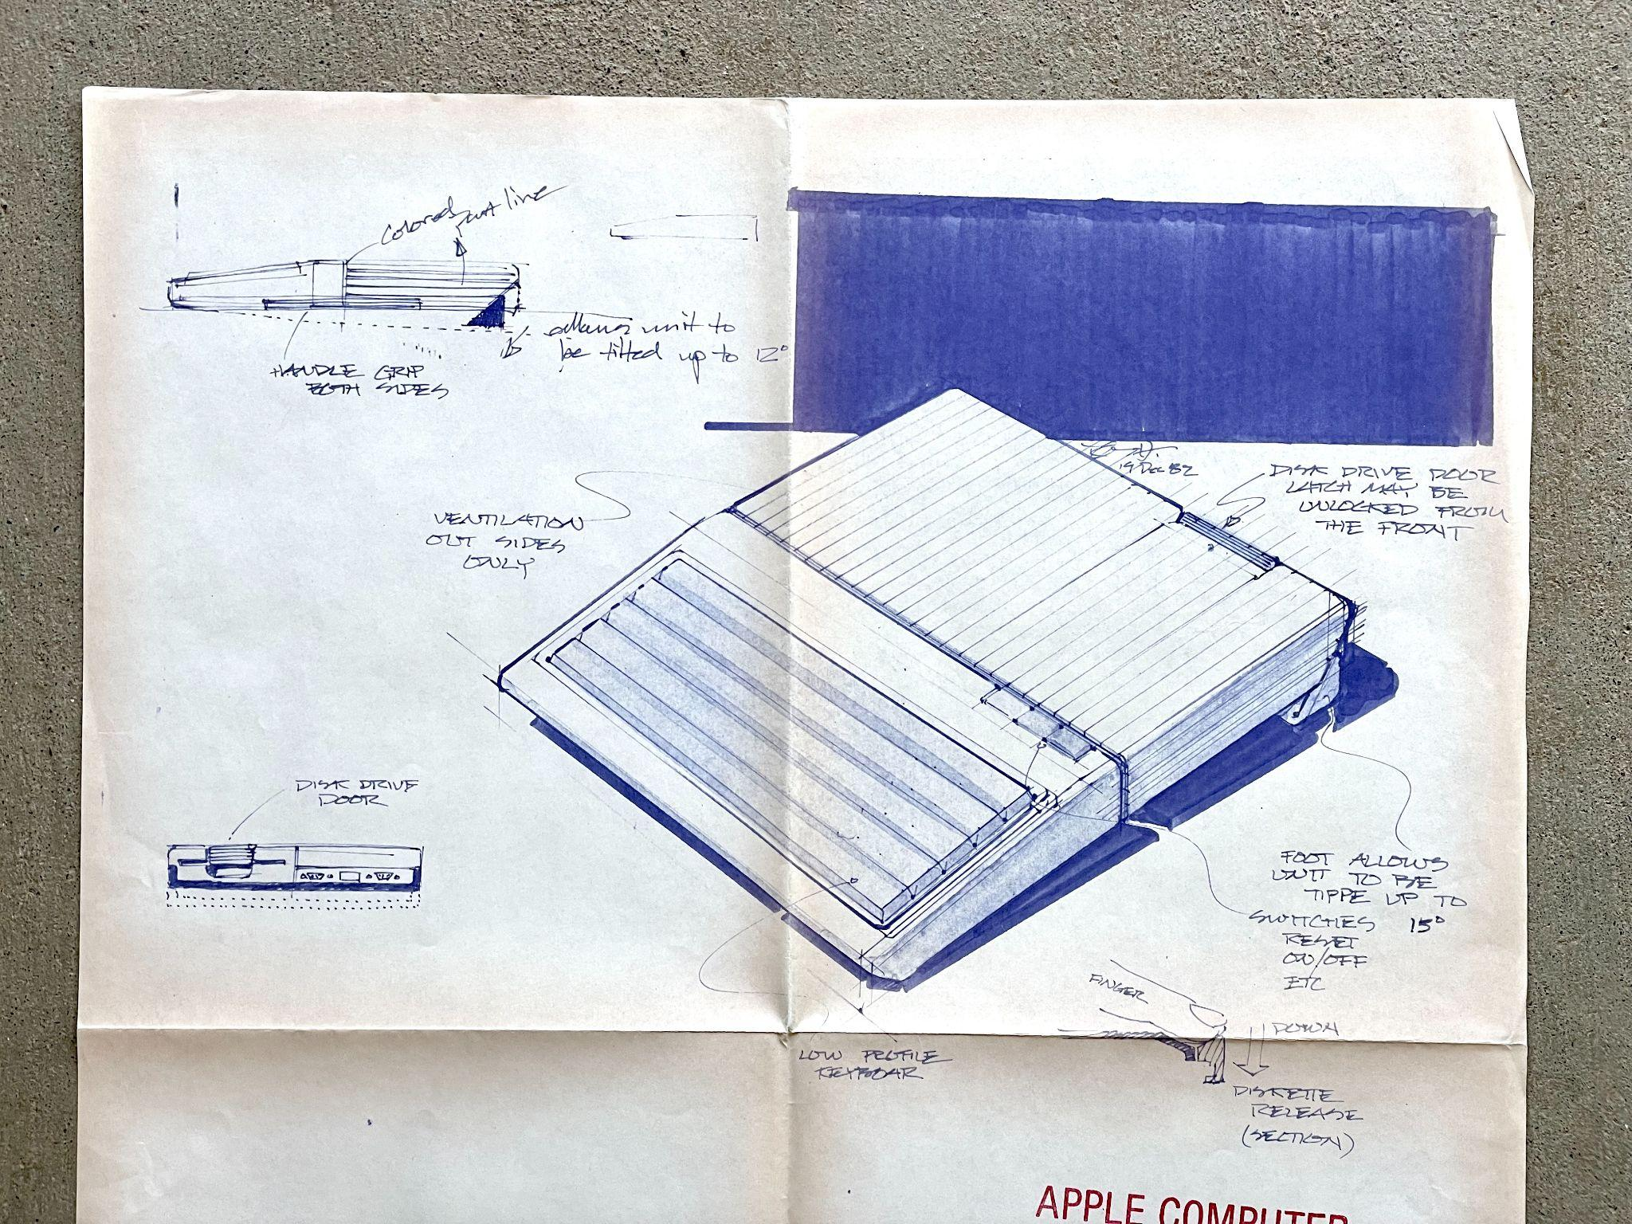
Notes:
Here come the Germans

Slide 22
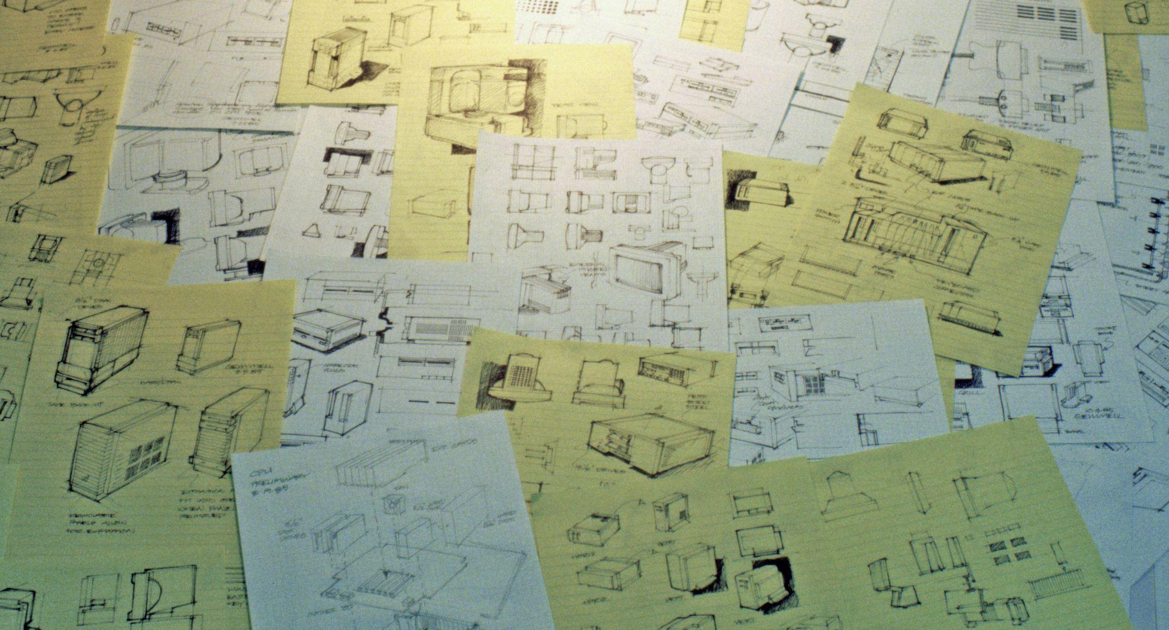
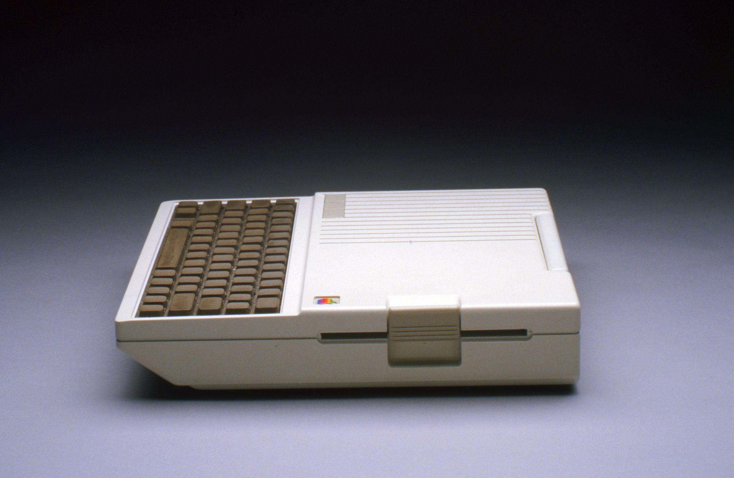
Notes:
Iterate, Iterate Iterate

Slide 23
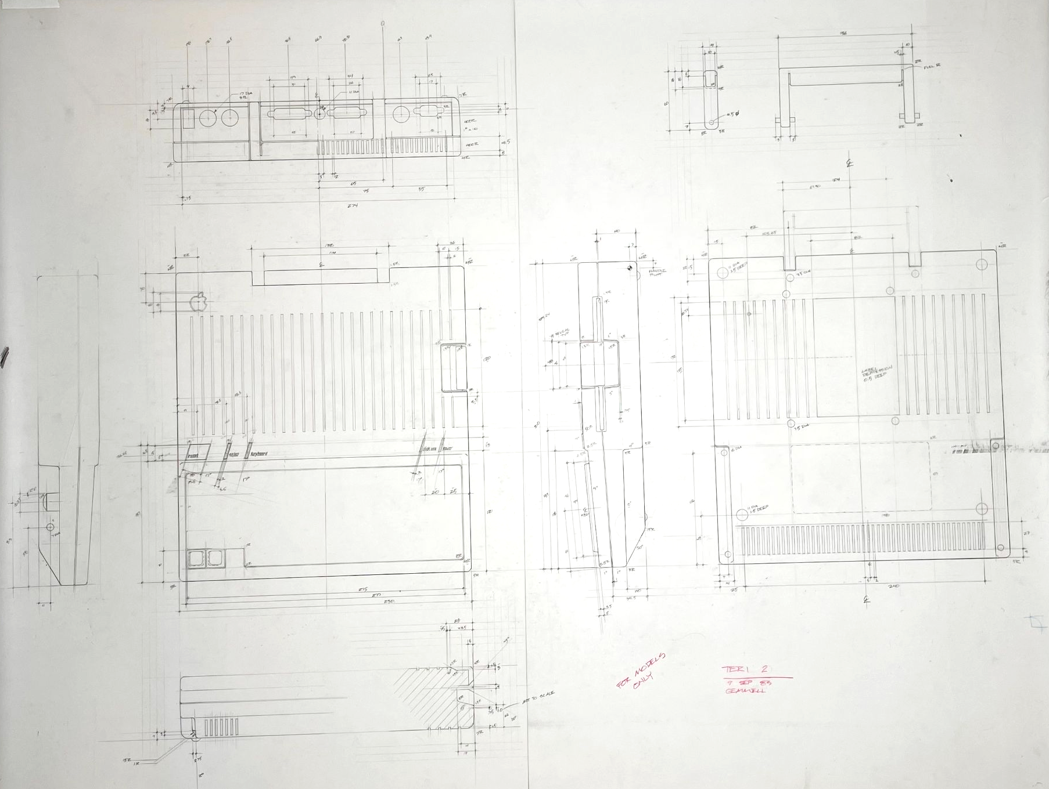
Notes:
One of over 10 layouts

Slide 24
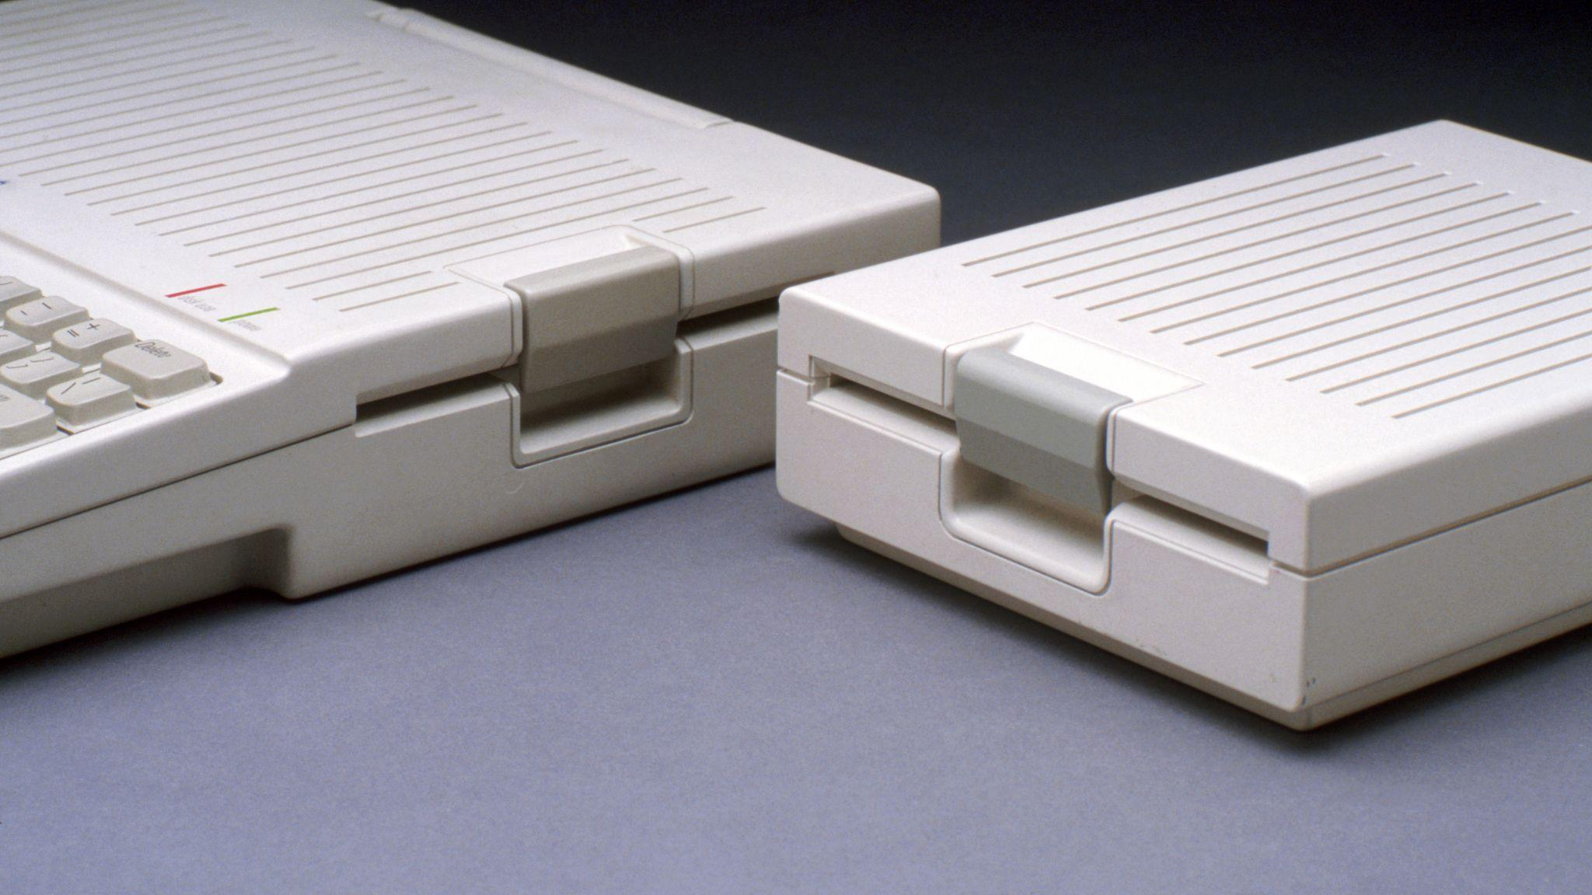
Notes:
Attention to detail

Slide 25
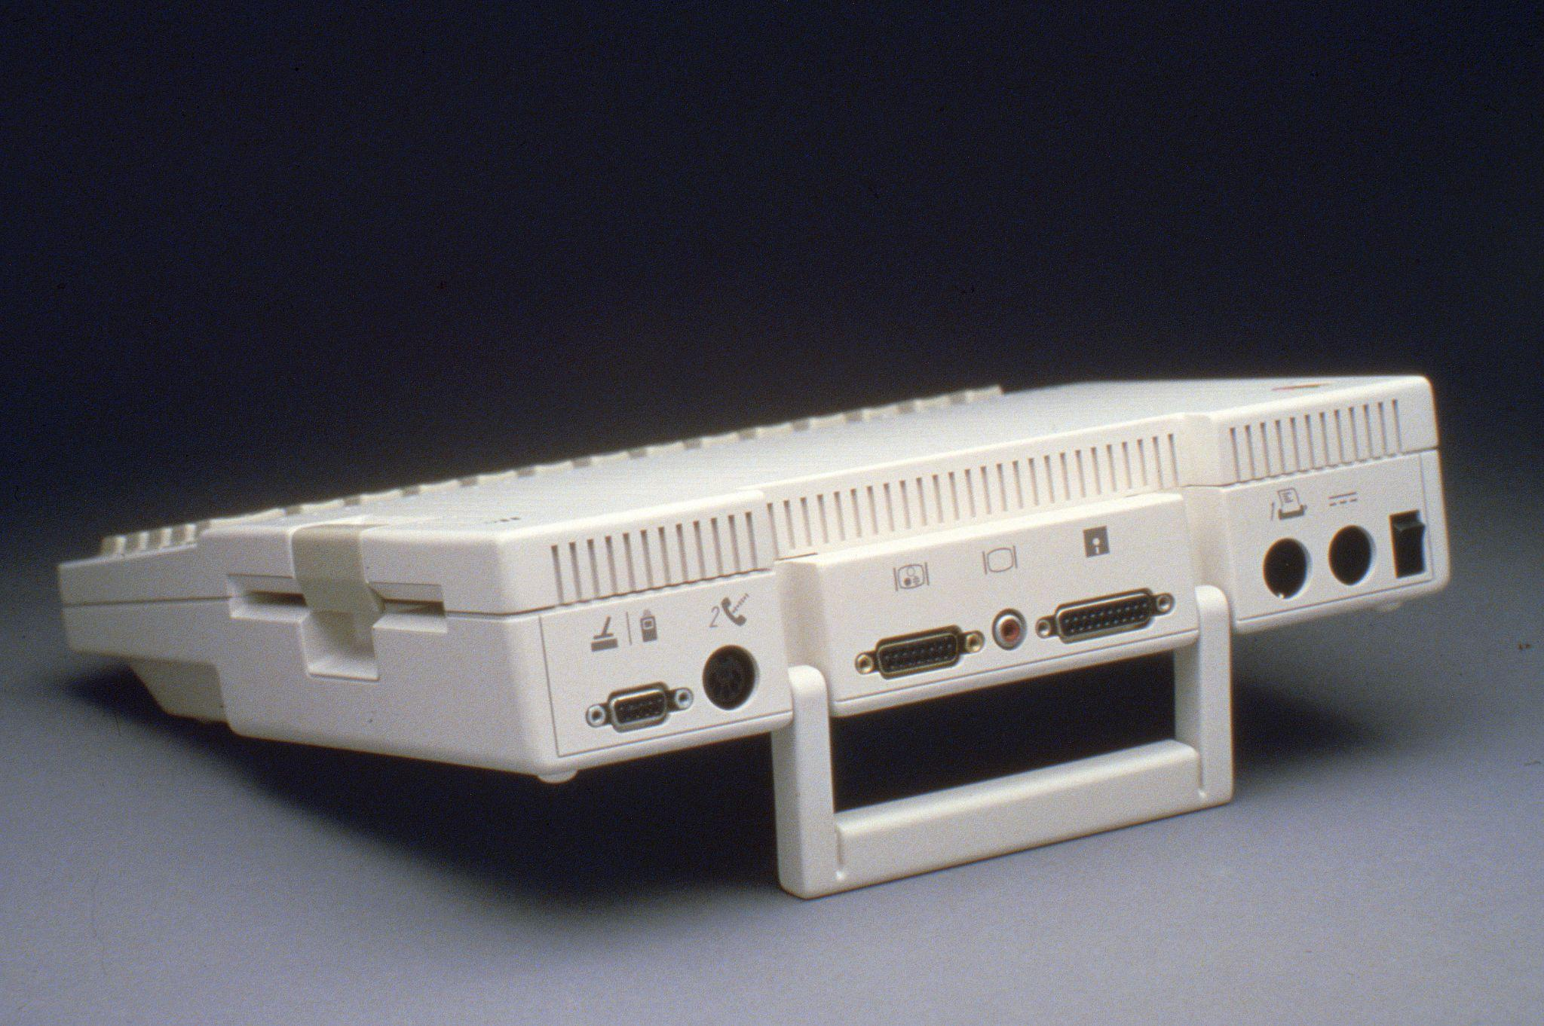
Notes:
Attention to connectors!

Slide 26
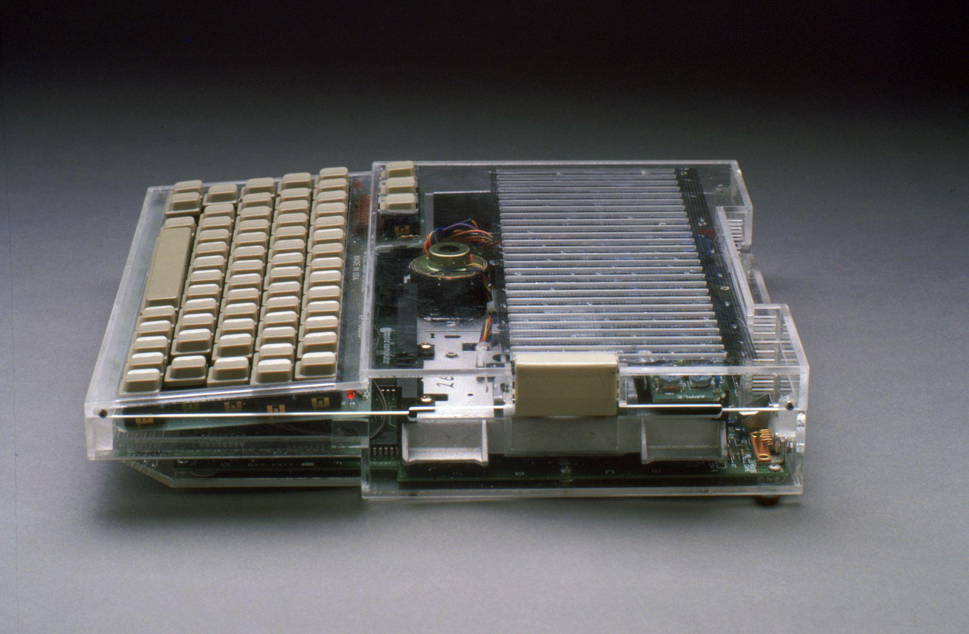
Notes:
Attention to heat!

Slide 27
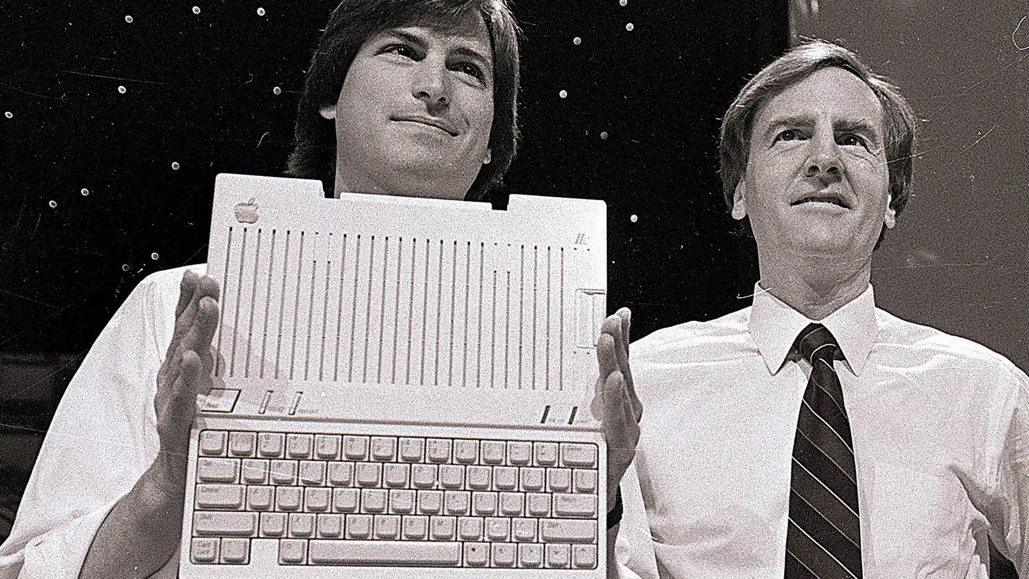
Notes:
The Intro event

Slide 28
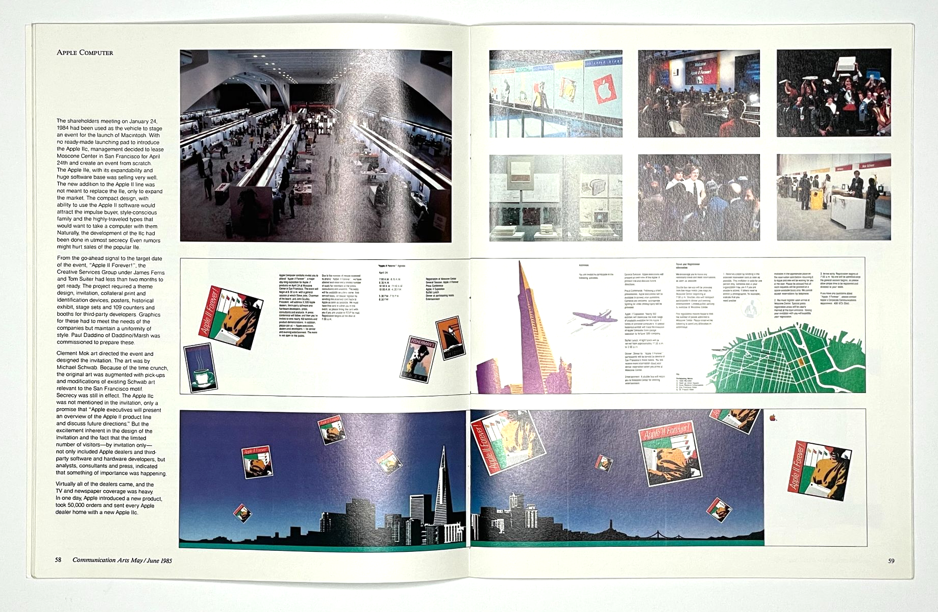
Notes:
Took over Moscone Center - bigger than the Mac Intro

Slide 29
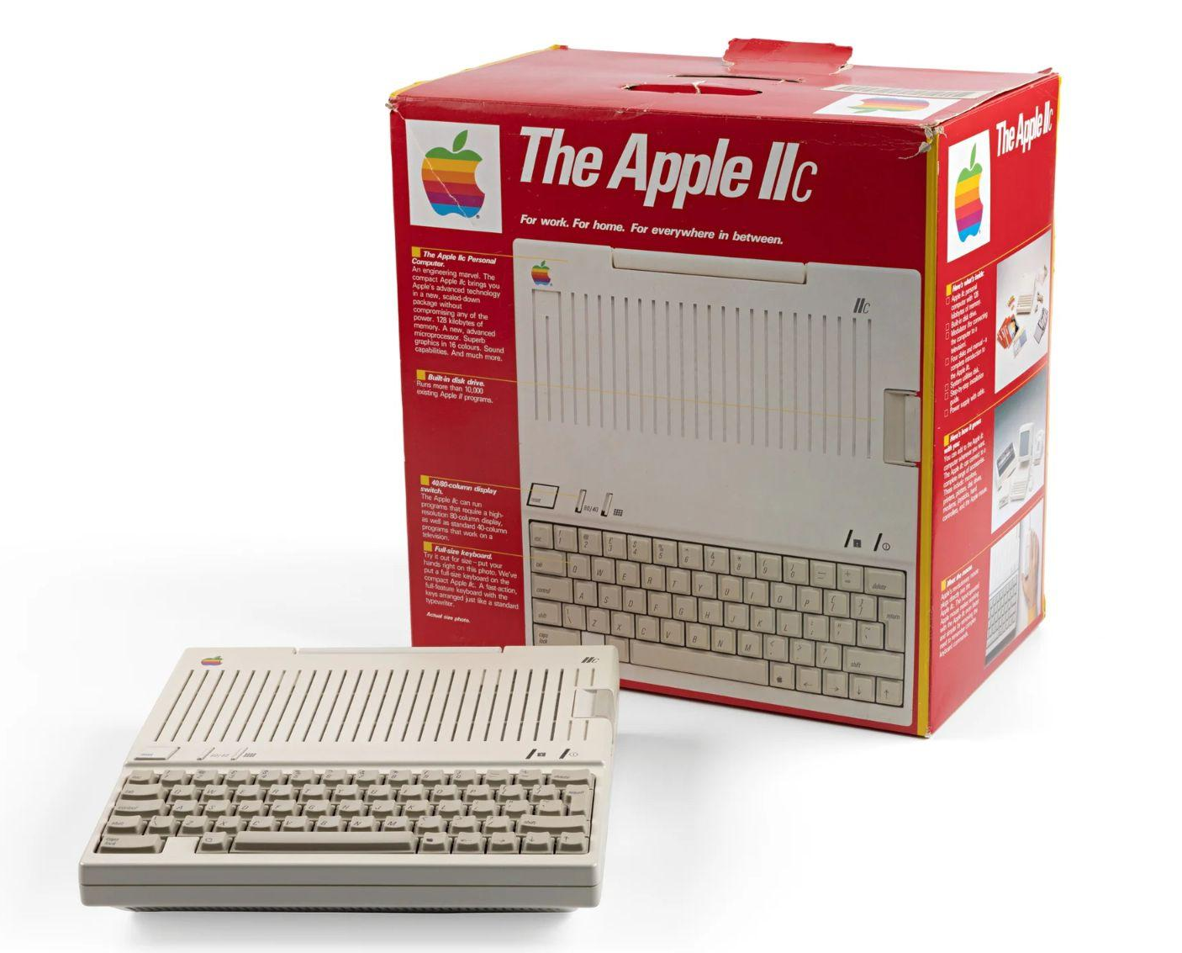
Notes:
50k Units pre-ordered

Slide 30
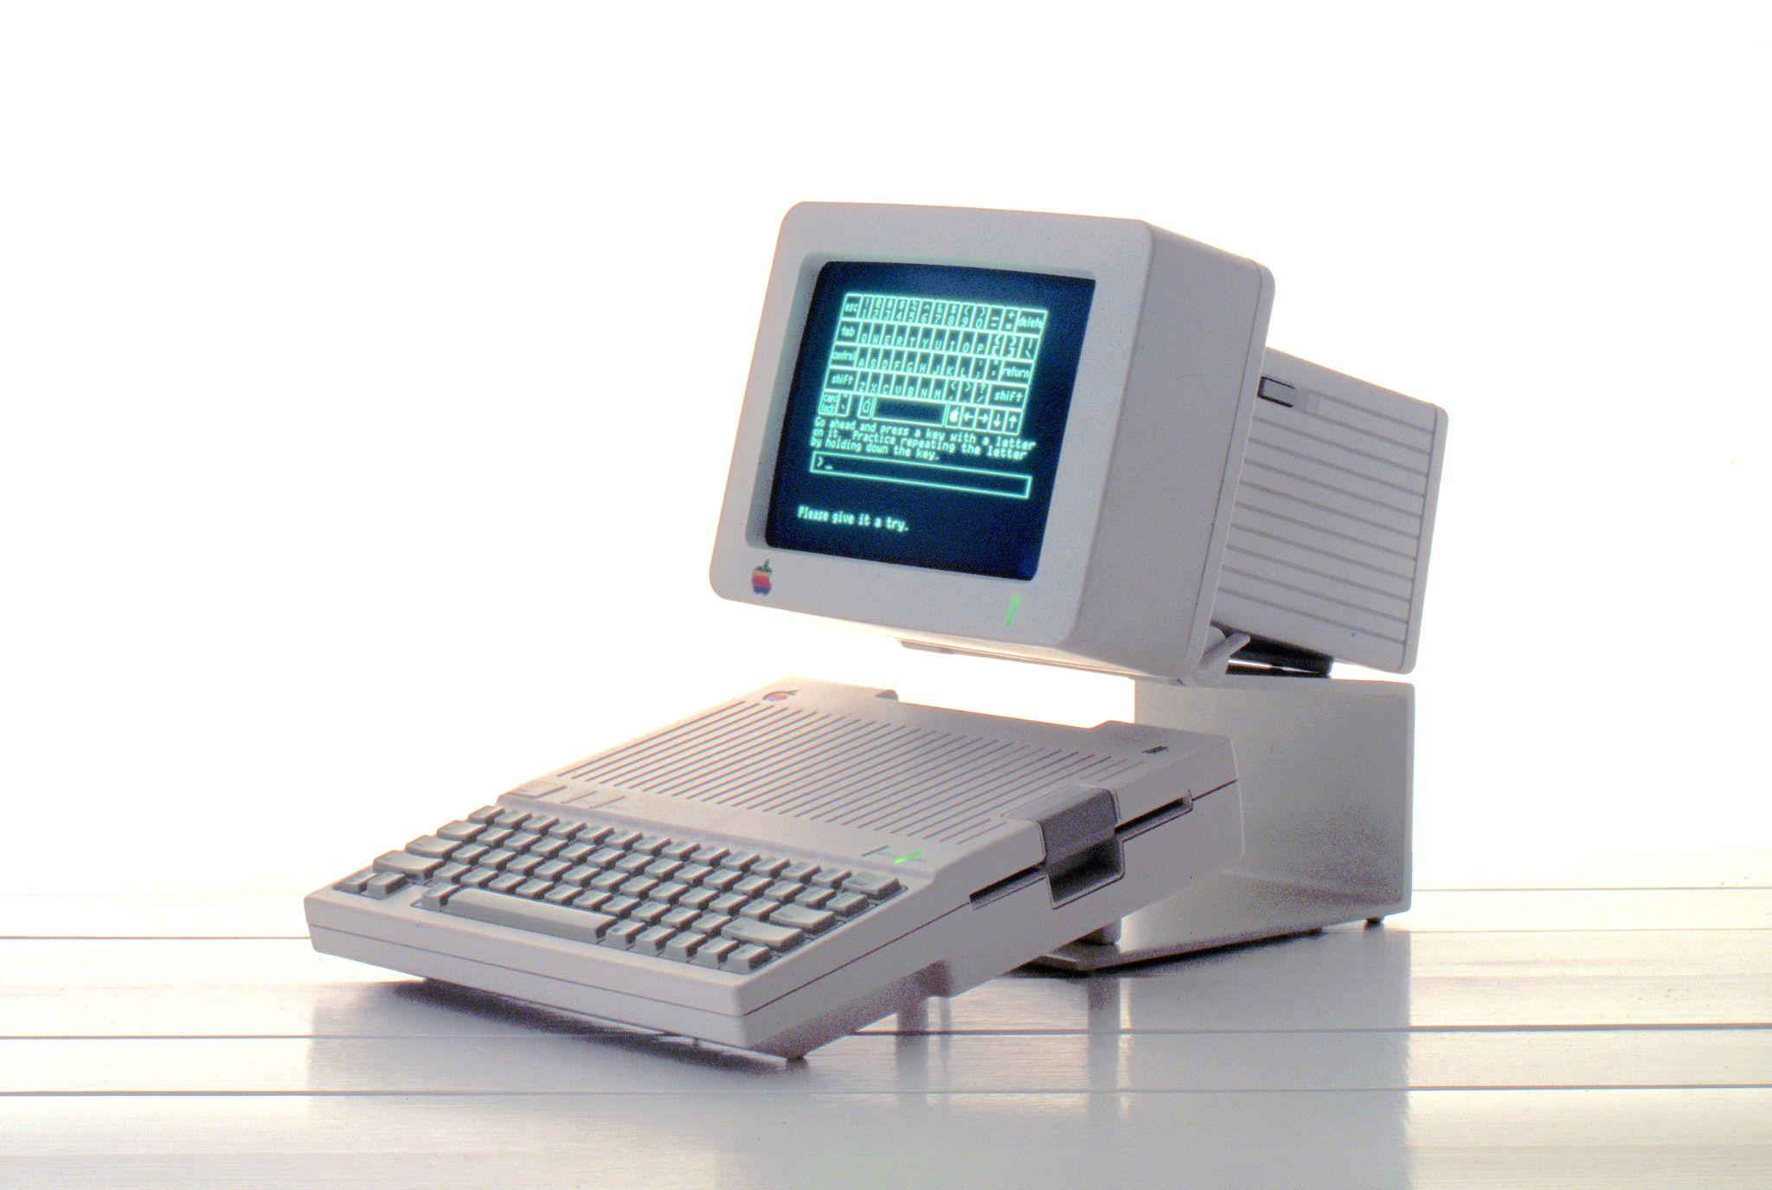
Notes:
Fastest Monitor project ever

Slide 31
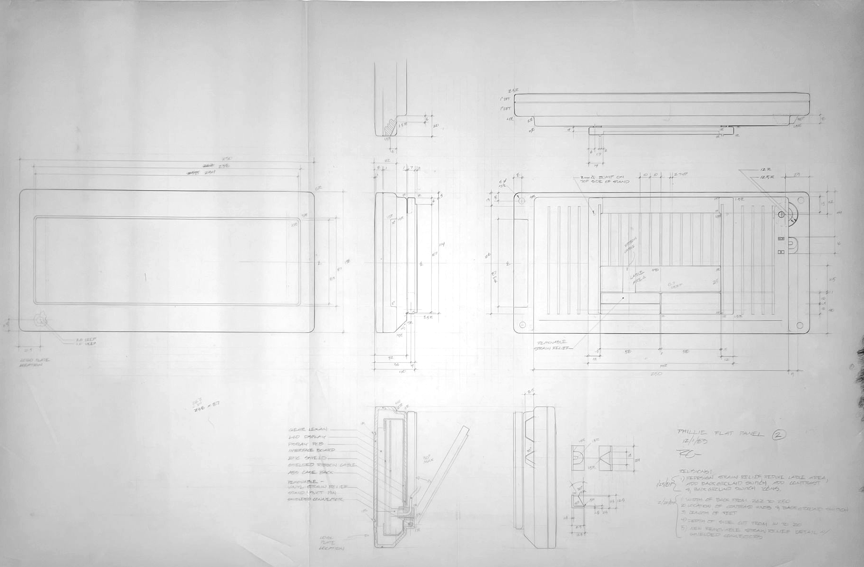
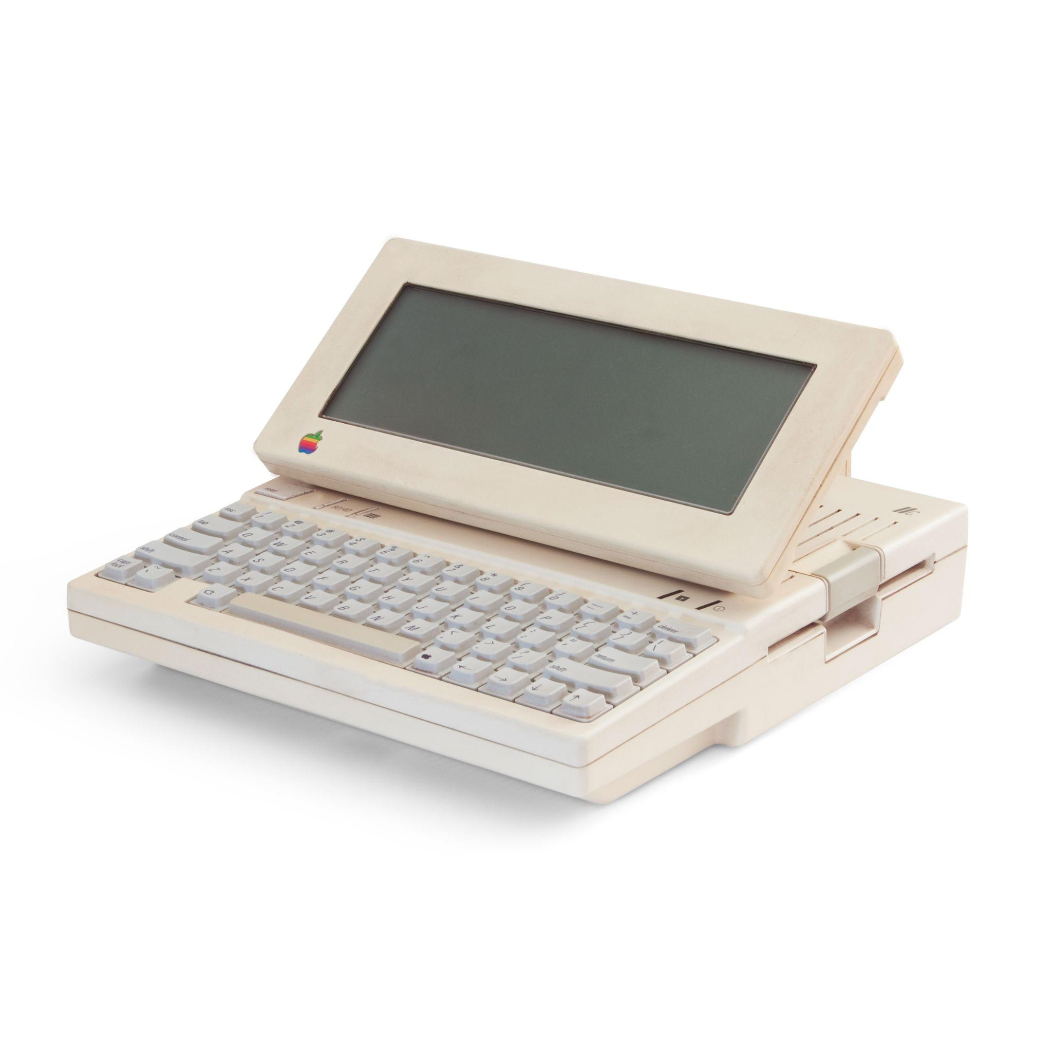
Notes:
My final product design at Apple

Slide 32
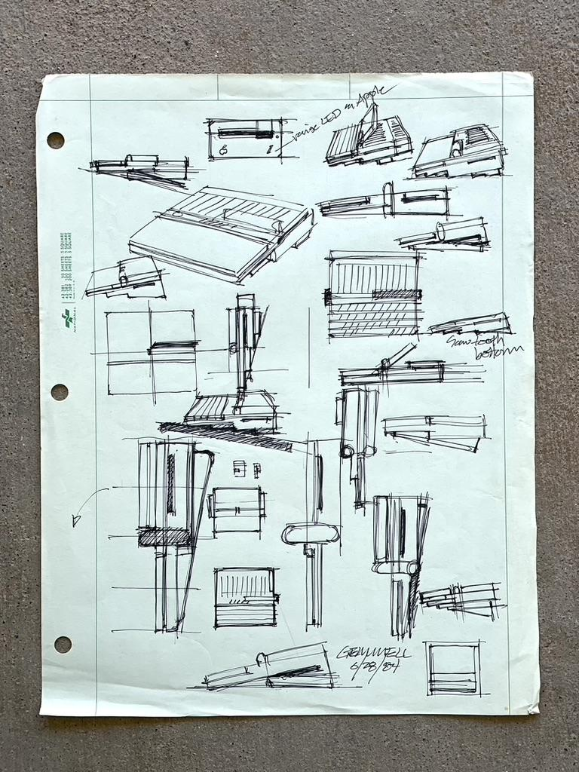
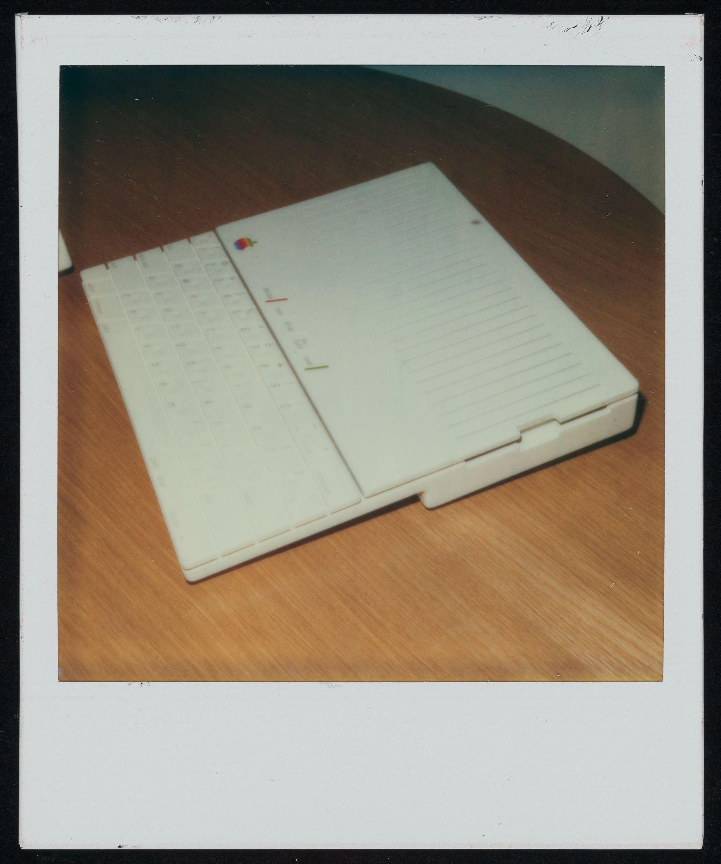
Notes:
IIc Next

Slide 33
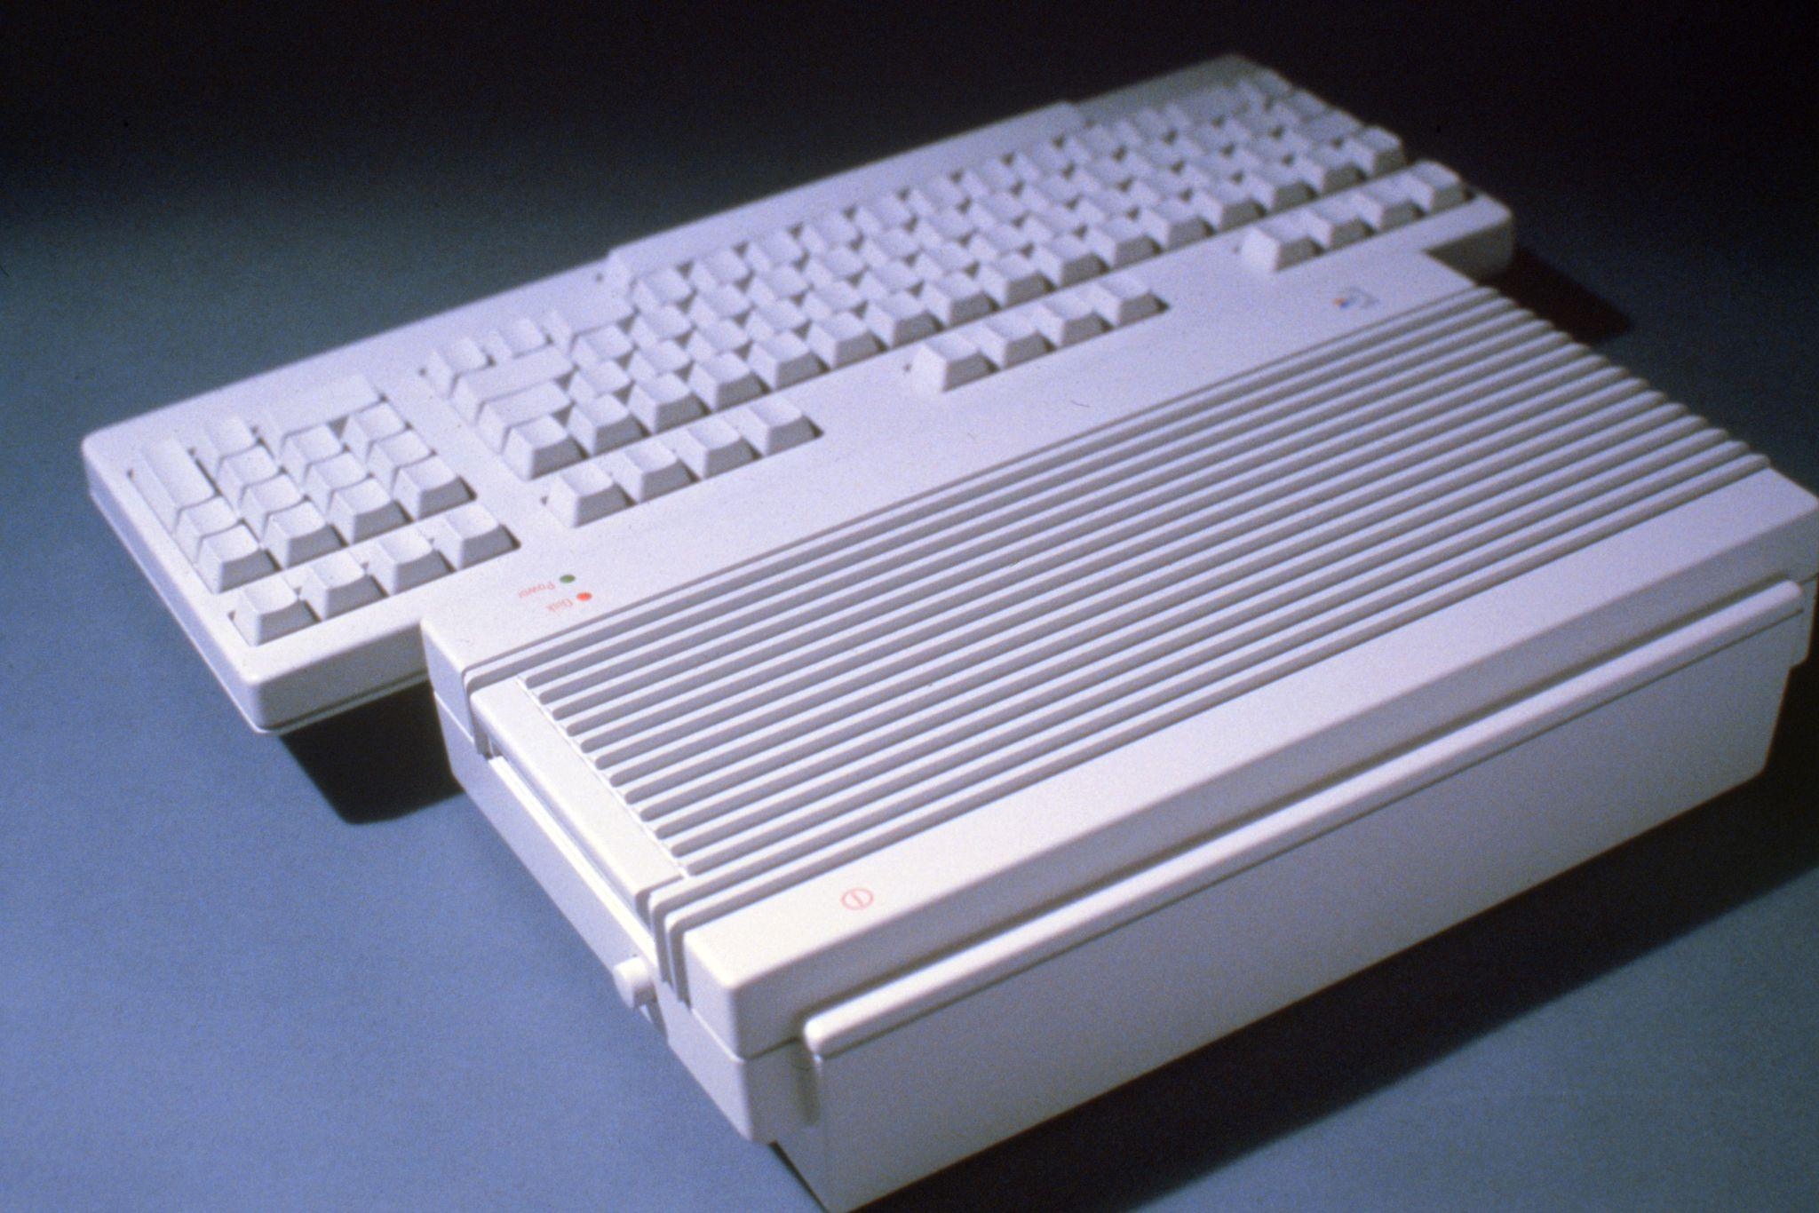
Notes:
Amiga - Cutting edge vs. Cuddly

Slide 34
Apple //c
Forever!

Slide 35
Notes:
Who me?

Slide 36
Apple IIc
Backstory
Who, me?
Apple staffing - not scientific
So close to Steve, but not
Into the deep end
Apple /// hangover
Wandering in the “concept” forest
Apple IIe
Apple __?__
What is this piece of…
Journey
Grid computer
Mini Apple II
Portable Apple II?
ELF
Snow White Project
Our Dwarf
Here come the Germans
Frog wars
Iterate, Iterate Iterate
Fastest Monitor project ever
Aftermath
The Intro event
50k Units pre-ordered
Accessories
IIc Next
Creative Pivot
Steve’s gone
Amiga - Cutting edge vs. Cuddly
Next Cube

